Slide 1
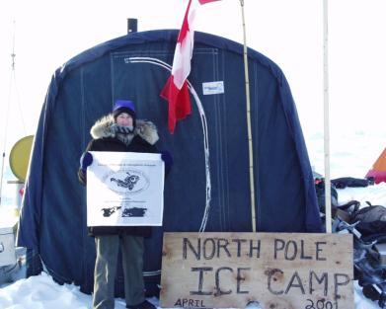
Polar Programs: An Overview
Dr. Kelly Kenison Falkner
Director, Polar Programs
October 16, 2012

Slide 2
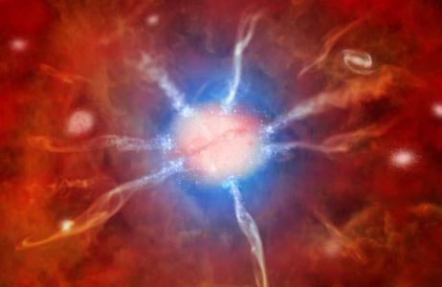
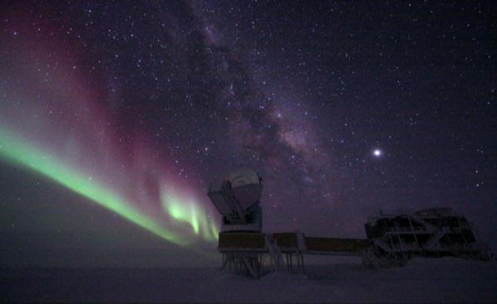
South Pole 10-m Telescope

Slide 3
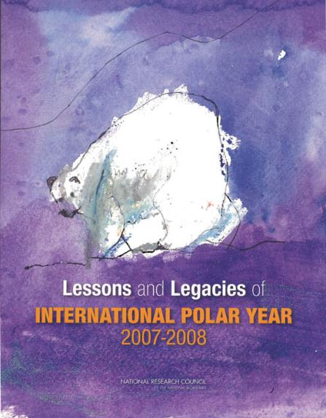
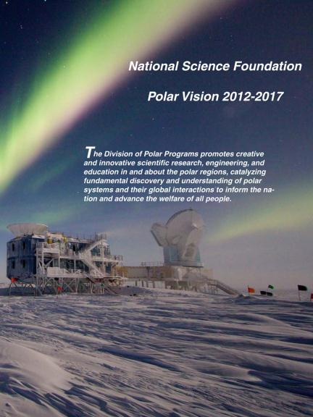
Polar Programs Vision

Slide 4
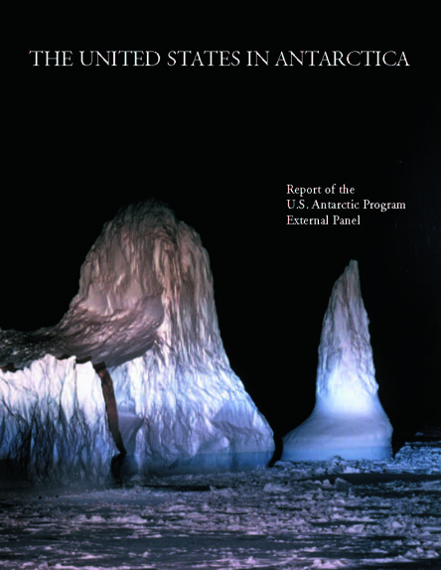

Slide 5
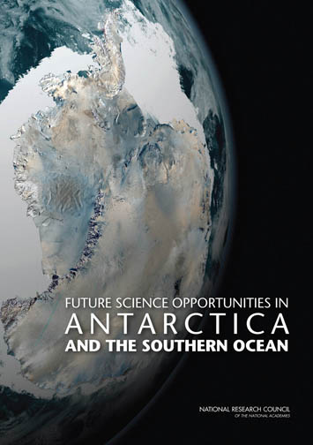
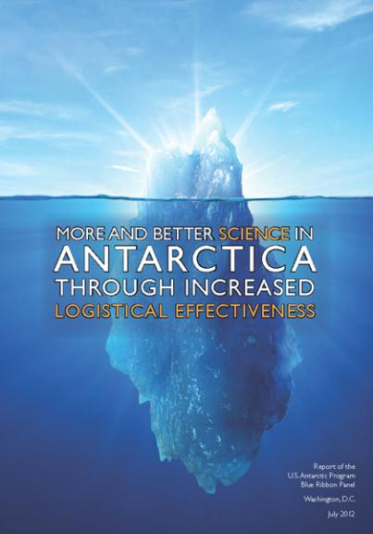

Slide 6
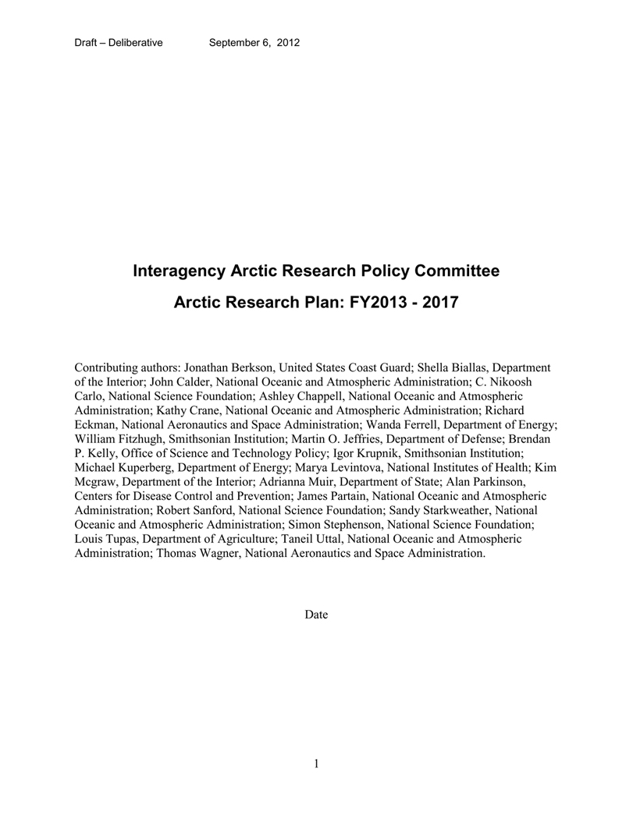
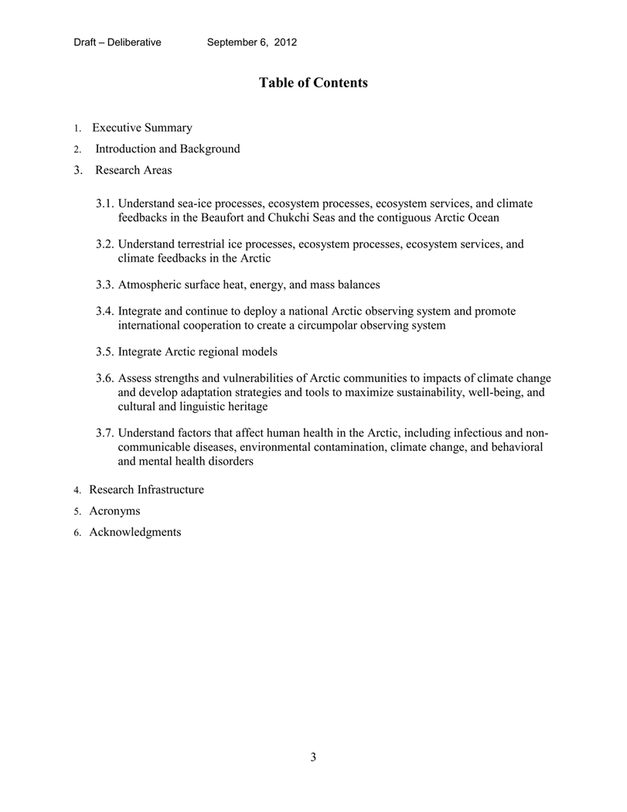

Slide 7
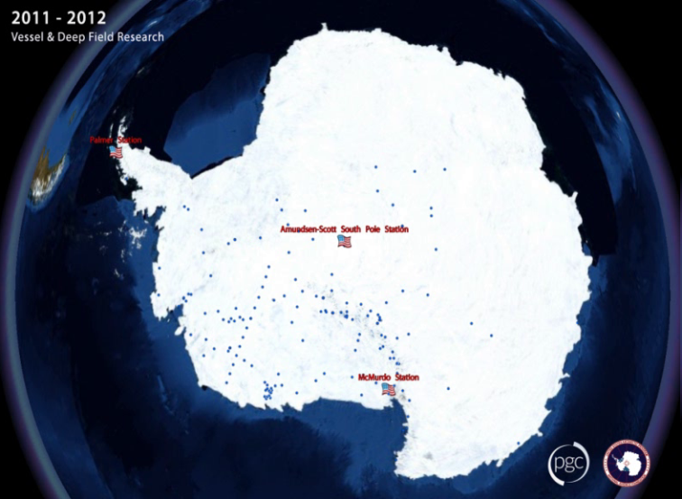
U.S. Antarctic Program
Research sites 2004-Present (animation)

Slide 8
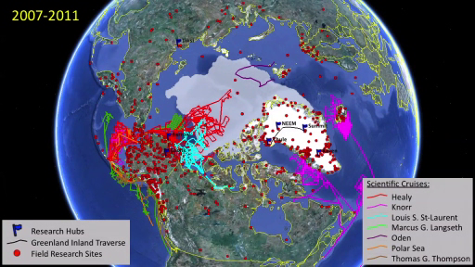
ARMAP Arctic Map (animation)

Slide 9
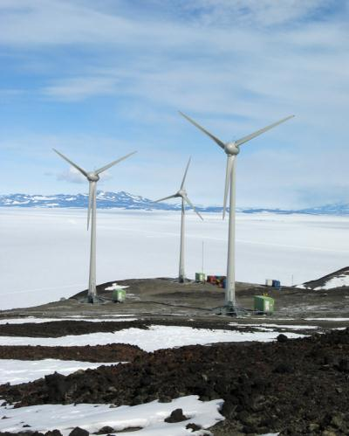
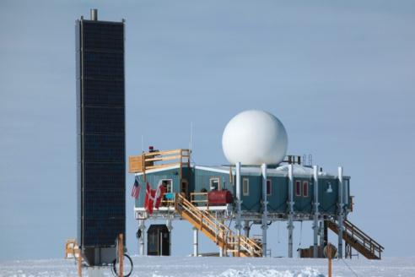
Sustainable Support

Slide 10
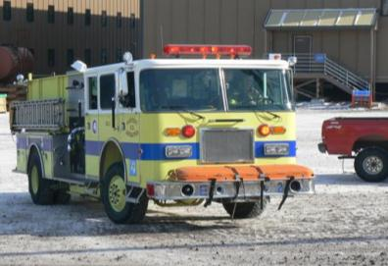
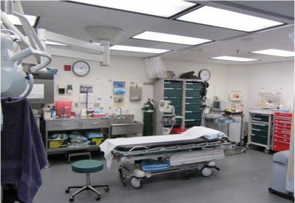
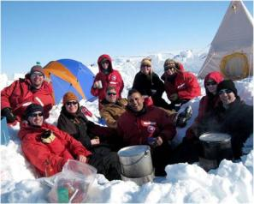
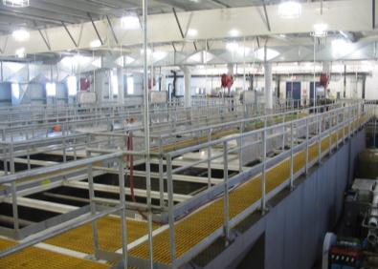
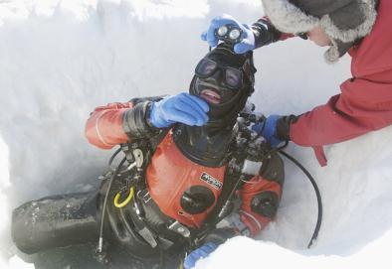
Polar Environment, Health and Safety

Slide 11
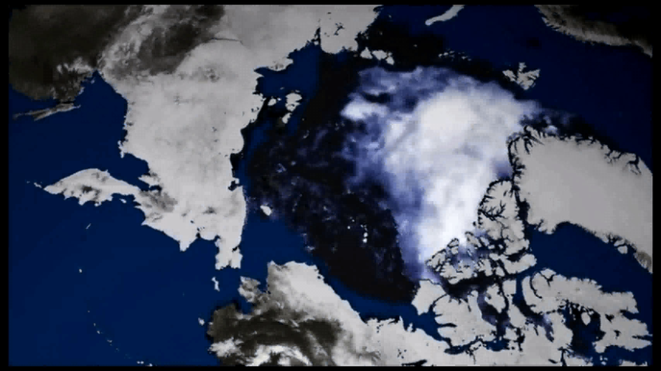
OPP Big Stories
Arctic Sea Ice minimum video, produced by the Yale Forum on Climate Change & Media

Slide 12
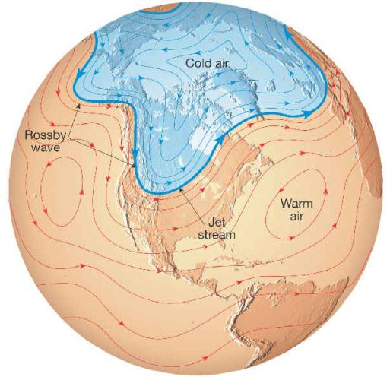
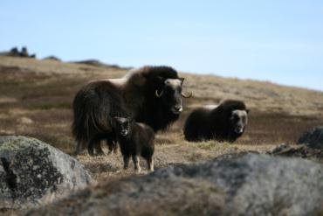
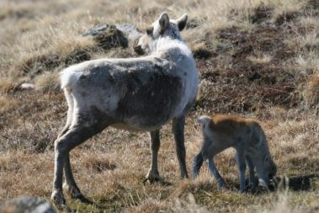
Implications: alteration of storm patterns, phenologies, migration, disease

Slide 13
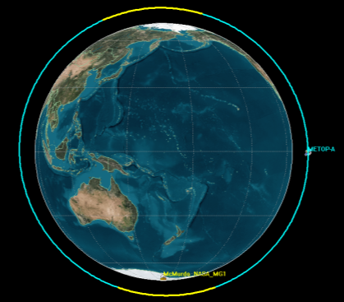
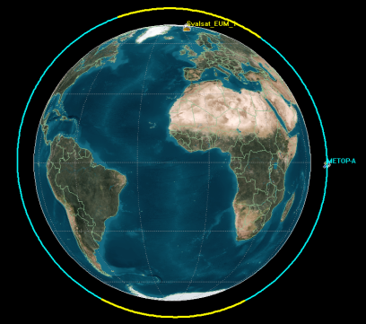

EUMETSAT Metop-A Environmental Satellite
Real-time data flow via McMurdo cuts data delivery time in half
Latency goals for weather “now-casting” met
NOAA as recipient of data - benefits for U.S. national weather forecasting
Svalbard Earth Station
Lat: 78.2286° N
Lon: 15.4014° E
Orbital Period = 101 min
Data Recovered ≅ Every 50 min
McMurdo Earth Station
Lat: 77.8391° S
Lon: 166.667° E

Slide 14
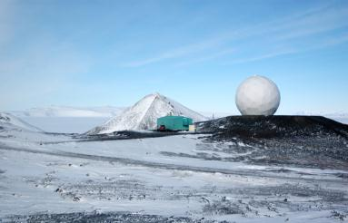
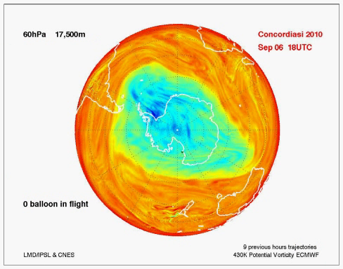
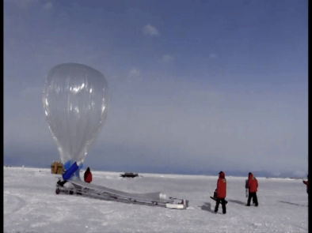
What has polar science done for you lately?

Slide 15
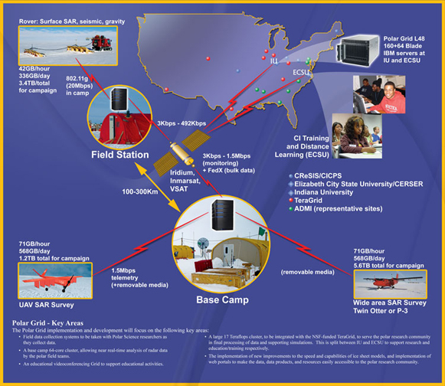
CReSIS
&
PolarGRID

Slide 16

Other Big Stories…
Land ice loss/Polar GRID video

Slide 17
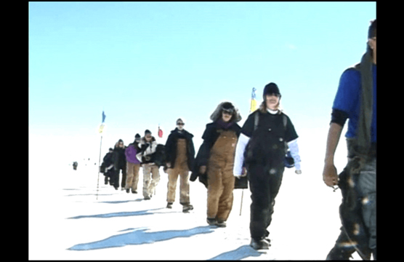
Joint Science Education Project in Greenland
(video)

Slide 18
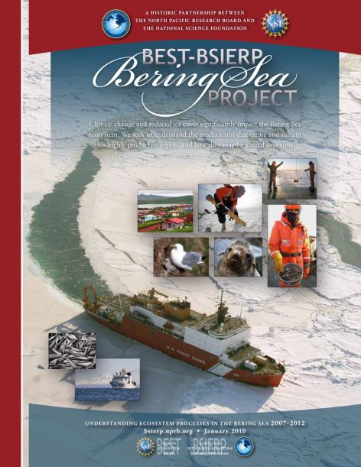
BEST

Slide 19
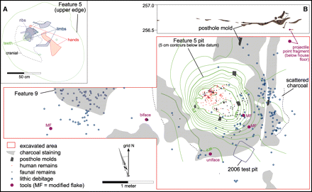
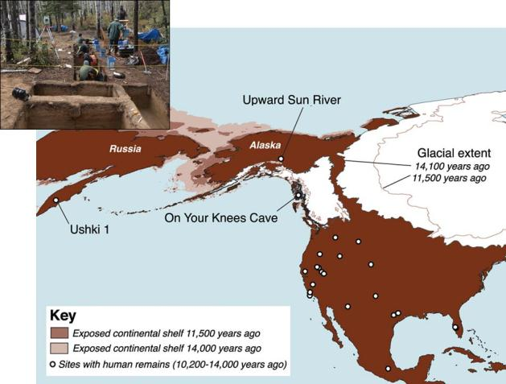
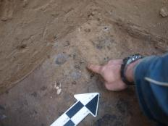
A Terminal Pleistocene Child Cremation and Residential Structure from Eastern Beringia
Dr. Ben A. Potter, UAF
lower left perm. 1st molar
Ben A. Potter,* Joel D. Irish, Joshua D. Reuther, Carol Gelvin-Reymiller, Vance T. Holliday
Published 25 February 2011, Science 331, 1058 (2011)

Slide 20
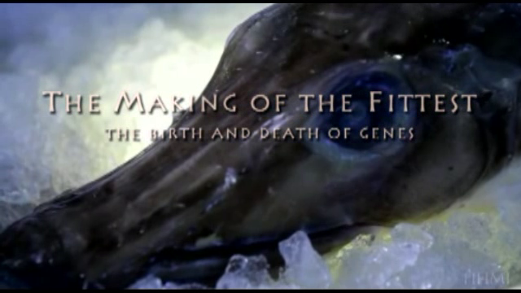
Ice Fish Genetics
Howard Hughes Medical Institute video

Slide 21
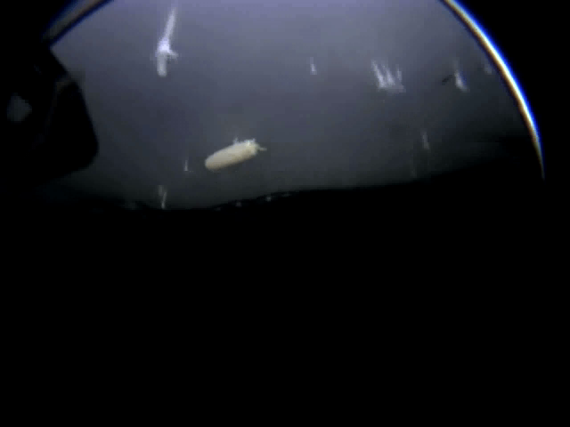
Exploration/Discovery (video)

Slide 22
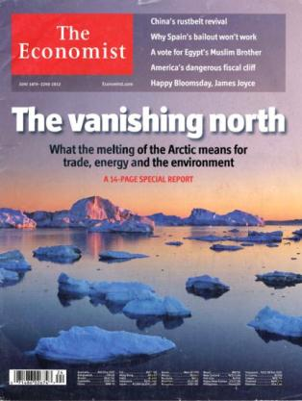
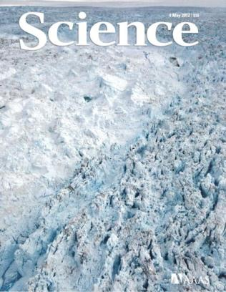

In the Public Eye

Slide 23
Supplemental Slides Follow

Slide 24
Office of Polar Programs Budget
*Numbers are in units of million $US

