Slide 1
Proposal Review Process: Logistical Considerations for Antarctic Science Proposals 20 April 2012
Scott Borg
Director, Division of Antarctic Sciences
Office of Polar Programs
National Science Foundation

Slide 2
Science Proposals
Basic Research
Respond to best ideas from the community
Transformational, frontier, high-risk/high-reward
Ideas, not cost, is main driver
Need for flexibility as project unfolds
Need for flexibility as program evolves
One principal deadline per year – early June
Success rate – 20-40% over last 10 years
Avenues for cooperation/joint consideration with other NSF Directorates, Agencies, and National Antarctic Programs

Slide 3
Review Process
Science Merit Review
Confidential; ad hoc and/or panel; advisory to NSF
Two NSB approved criteria, plus:
Rationale for Antarctic field work
Logistical feasibility of proposed work
PI generates a statement of resource needs with input from the contractor; statement made available to reviewers/panelists
Reviewers/Panelists know some resources are expensive and/or involve significant opportunity costs – e.g., ship time, LC-130 support

Slide 4
Review Process
Program Officers
PO’s address field work; generally discuss with the panel
PO’s have discretion to discuss specific logistical issues with the panel
PO judgment defines suite of fundable proposals for logistical and supportability evaluation

Slide 5
Logistical Review
Prior to proposal submission – discussions with NSF and/or ASC strongly encouraged
Prior to award decision –
Operational plan focused on technical requirements (PI/ASC/NSF)
NSF judgment regarding operational (and opportunity) costs
OPS Notice/Agreement
Some costs are discussed explicitly
NSF is responsible for overall cost and resource optimization

Slide 6
Making Awards
Generally,
Science “Plan” (i.e. proposal)
Logistics Plan
Feasibility, Supportability, Costs
Award
For some projects,
Planning award with milestones, additional review (options, costs, tradeoffs, etc.), decision points, exit ramps

Slide 7
Field Support
Support plans and parameters in place at start of grant for entire field program – even if multiple years
Structure and staffing are based on operational, environmental, and safety assessments
NSF needs to
Remain flexible to allow for possibility of changes in scope
Have a deliberate and well-communicated process for changing field plans
Continuous Improvement

Slide 8
Summary - Philosophy
Apply good project management methods to field work for all projects – NSF and mission agency
Full understanding of project needs at start
Robust operational plan
Formal coordination with and leveraging of other NAPs and agency partnerships
Agreement on how to deal with dynamic factors
Schedule for Success
“Don’t leave resources and capacity on the table”
Integrate all projects in an overall program

Slide 9
Questions?
Photo: S. G. Borg

Slide 10
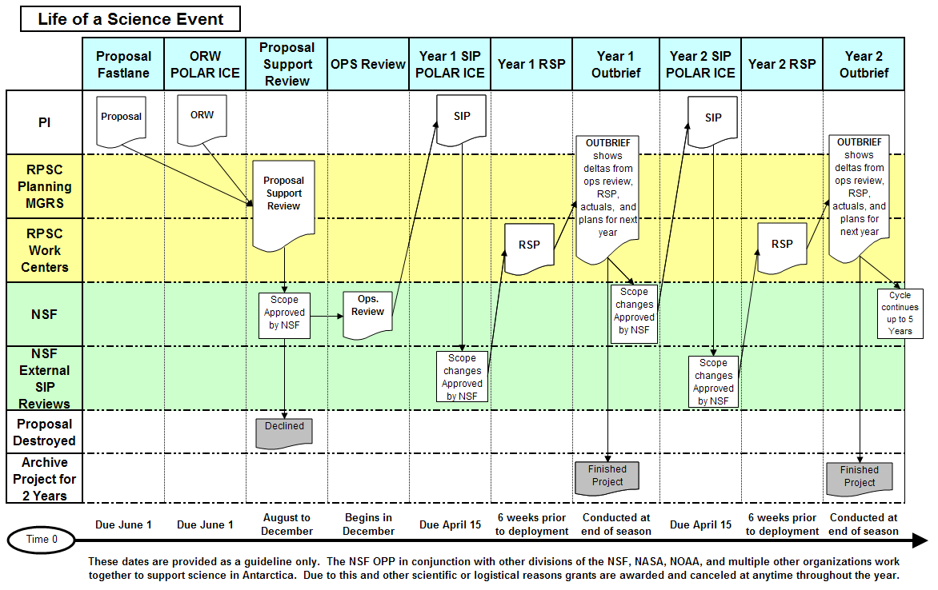
POLAR ICE & Science Grant Lifecycle
Contractor
Planning
Managers
Contractor
Work
Centers
Dialog – PI, ASC, NSF

Slide 11
POLAR ICE Integration with NSF Grant Proposal Process
NSF
FASTLANE
Prepare
ORW?
NO
Grant
Proposal
Process End
INPUT:
NSF Proposal No.
Grantee data entry
YES
OUTPUT:
Operations Review
Feasibility
Trade-offs
ORW
ASC Contractor
OUTPUT:
ORW
Contractor
Support
Reviewer
NSF Program
Manager
Reviewer
Season 1
Planning
Document
Ops
Review
Season 2
Season 3
INPUT:
Grantee Requirements
Resources
Resource Allocations
Conflicts/Priorities
NSF Fund
Project?
Process End
OUTPUT:
Funding Memo
Award #
Event #
NO
Grantee
SIP
YES
NSF
OUTPUT:
Data to Generate RSP
RSP
Customer Commitment
ASC
Contractor
POLAR ICE v 3.6
RSP Uploaded into POLAR ICE

Slide 12
Science Support Review Cycle
June 1 NSF receives proposals
September Review Panels
October Contractor reviews support requirements
November “Bucket Review”
December NSF makes initial selection of new projects
January Proposal Review Document produced
Jan - Aug Detailed season planning
Notes:
Most proposal are received on or about June 1 each year. Some special programs have other deadlines. We have also accept proposals outside of the deadlines.
Copies of proposal, and accompanying operational support forms are forwarded to the contractor for their review.
The contractor assist this process to keep track of critical resource allocations, and that allocations are within support limits.
The contractor will distribute selection information internally to assist pre-positioning resources (equipment and field camp materials). Very sensitive until final funding action is taken by NSF.

