Slide 1
U.S. Antarctic Program Resupply Perspectives
Brian Stone
Antarctic Infrastructure & Logistics

Slide 2
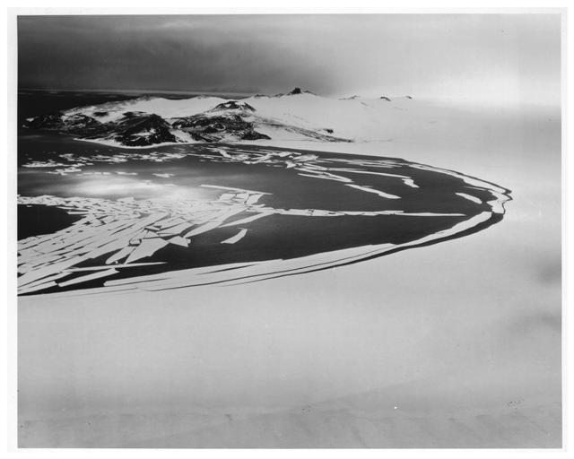
Why McMurdo Station?
Deep water access for ships
Relatively stable ice edge
Annual sea ice breakout
Access to Ross Ice Shelf and the continent
Critical for access to South Pole & deep field.

Slide 3
Vessel Operations Early Operation Deep Freeze
Ice edge cargo transfers
McMurdo break-in for fuel resupply
Unpredictable ice conditions increase risk.
Personnel losses
Cargo offload at McMurdo started mid-1960’s.

Slide 4
Vessel Support Over the Years
1950’s
US Navy ships
Navy & USCG operated icebreakers (smaller)
1960’s
US Navy transfers all icebreakers to USCG
1970s
NSF assumes full responsibility for USAP.
USCG commissions Polar-class breakers
1980’s
Introduction of civilian ships
2000’s
B-15 iceberg creates need for 2-ship ops
NSF contracts with FESCO for icebreaker support
NSF contracts with Sweden for ODEN
Present
MAERSK PEARY (tanker)
GREEN WAVE (dry cargo)
VLADIMIR IGNATYUK (icebreaker)

Slide 5
Key Considerations for Ships
Icebreaking or ice-strengthened
Must burn light fuels (MGO)
2011 IMO rule
Increases cost – limits availability of backups
Self-supporting for offload/onload (limited port facilities)

Slide 6
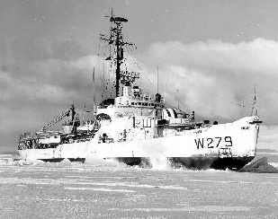
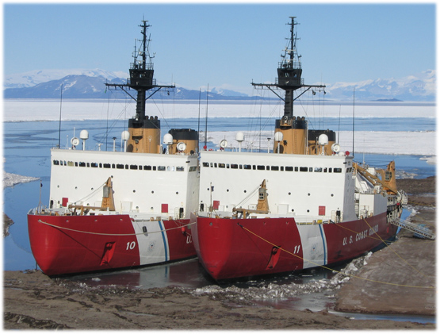
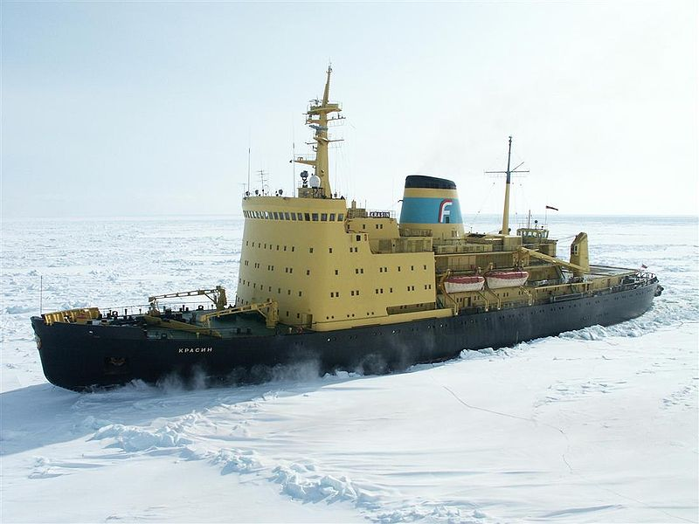
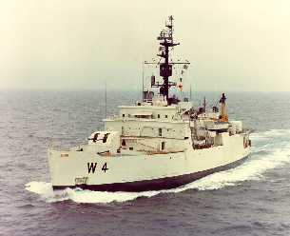
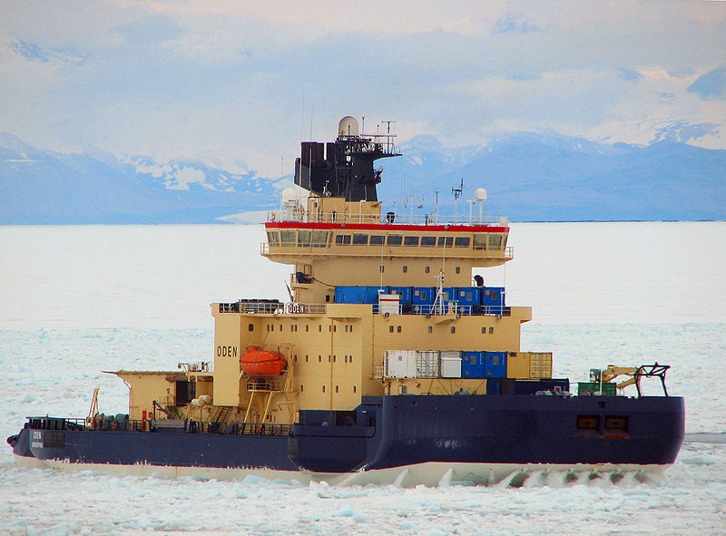
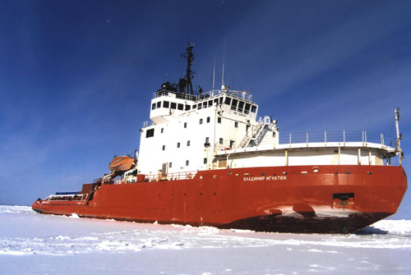
Icebreaker Support

Slide 7
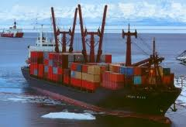
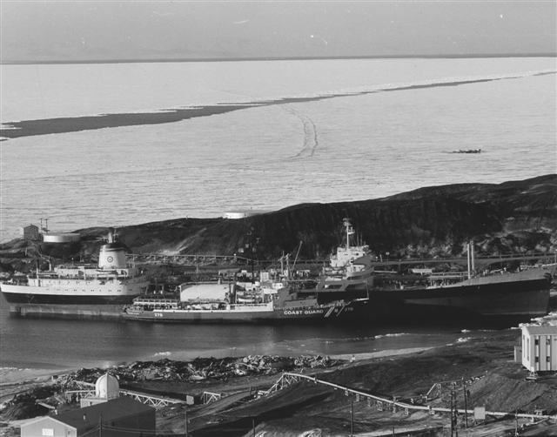
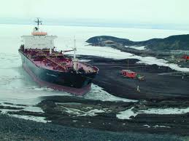
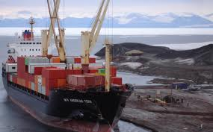
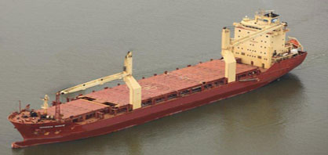
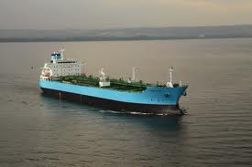
Vessel Support over the years

Slide 8
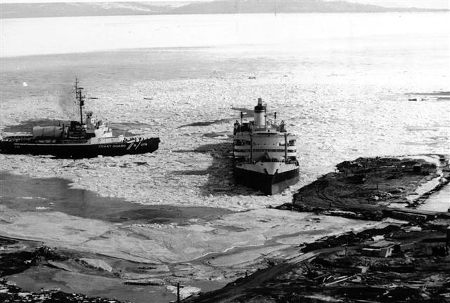
Ice Wharves and Piers
Mid-1960’s abandoned ice edge as routine site for cargo offload.
Introduction of containerized cargo meant higher weights and increased risk of ice edge transfers.
Improvements to “Edisto Quay” from 1969-1973.
Ice wharf destroyed in winter storm in 1973.
USAP switched to ice pier. (1973-present)

Slide 9
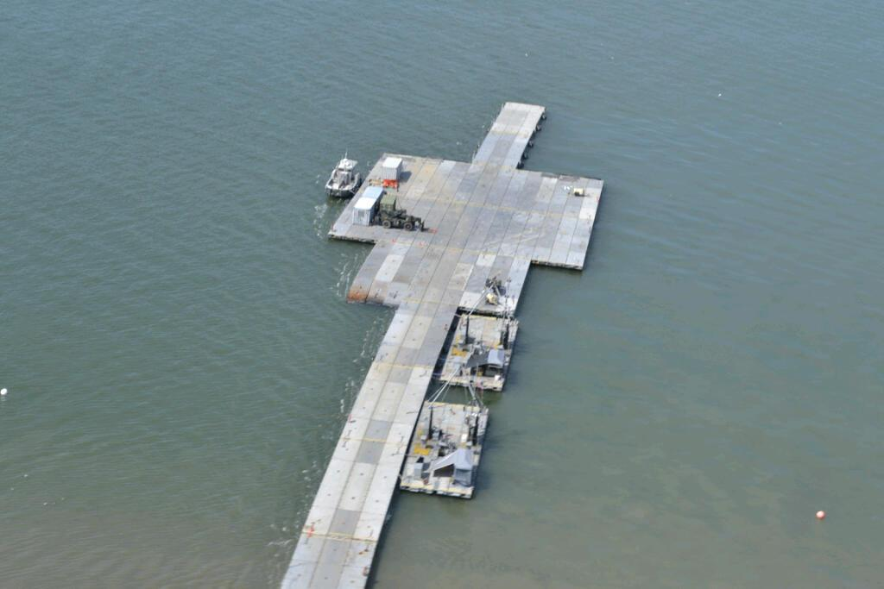
Modular Causeway System
Ice pier not suitable for cargo offload
US Army providing MCS and 40-person team to assemble.
Down and back on cargo vessel
3 days setup / 3 days teardown

Slide 10
USAP Cargo Vessel Movements
Southbound cargo volumes vary greatly with on-ice activities. Construction activity = more weight
Some cargo cannot be easily flown
Hazardous cargo
Frozen foods
Rolling stock & breakbulk
Northbound cargo drivers
Solid & Hazardous waste
Science cargo
Outsized items
Backlog of non-hazardous retrograde

Slide 11
USAP Airlift 1990-2010
Available Airlift (1k lbs)
Week of the Season

Slide 12
Transformative Capabilities
Pegasus Runway
First WINFLY/Late-Season use
White-ice development 2002 led to year-round wheeled ops by 2004
Greater flexibility in aircraft types
C-17 Globemaster 3
South Pole resupply capability – traverse and air support

