Slide 1
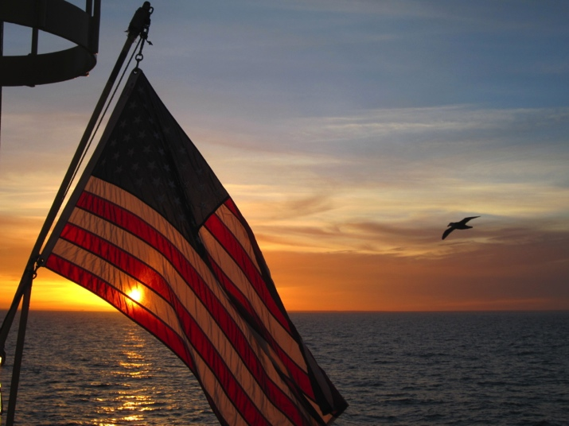
NOAA in the Antarctic
James H. Butler, Director
Global Monitoring Division
Earth System Research Laboratory
National Oceanic and Atmospheric Administration
Antarctic Logistics Blue Ribbon Panel
National Science Foundation
Arlington, VA

Slide 2
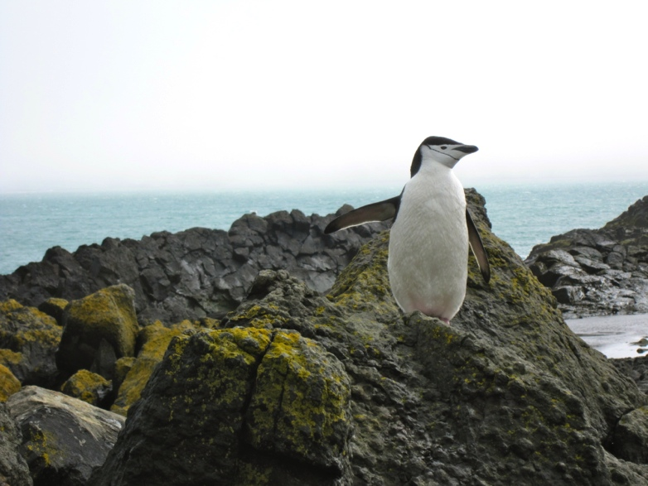
Overview
Long Antarctic research history (South Pole at IGY – 1957).
Continuous staff on continent since 1974… not one day gap!
Regulatory role for marine conservation and management.
Congressional mandate to monitor the Antarctic stratospheric ozone layer.
NOAA line offices with Antarctic projects:
National Environmental Satellite, Data, and Information Service (NESDIS)
National Marine Fisheries Service (NMFS)
National Weather Service (NWS)
Oceanic and Atmospheric Research (OAR)
Looking forward… needs identified by NOAA.

Slide 3
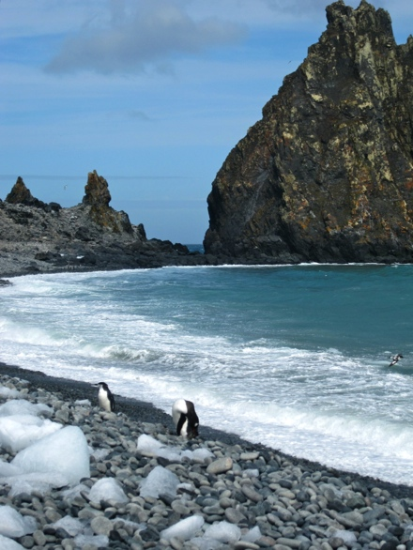
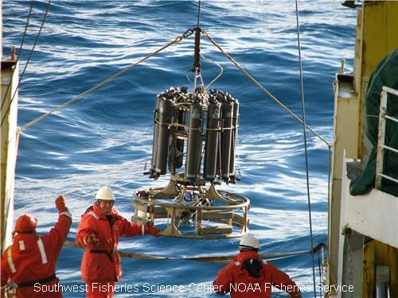
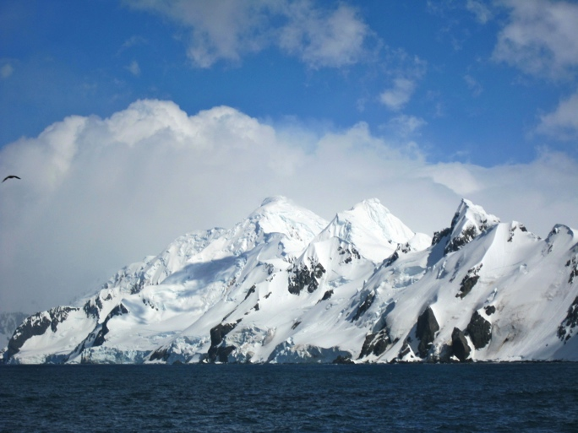
NMFS
Antarctic Marine Living Resources (AMLR) Convention Act of 1984 –
Establishes DOC’s responsibility for conducting “directed research” to support U.S. Antarctic policy, particularly with respect to the conservation and management of living marine resources in the Southern Ocean.
Current Activities –
Monitor Antarctic marine ecosystems and populations with annual scientific cruises and field camp research.
Interpret changes and predict impacts of fishing and climate change to fish and bird populations.

Slide 4
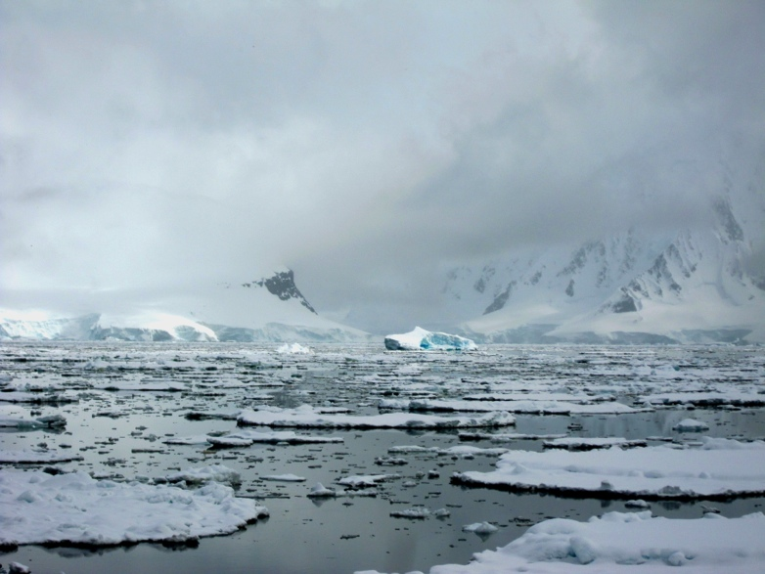
NESDIS & NWS
Current Activities –
Support for coastal stations (U.S. and international), also provide data for predictive weather models worldwide.
Process meteorological data from U.S. stations.
Collaborate with the National Ice Center – International Programme for Antarctic Buoys.
Future Endeavors –
Continue satellite support for multiple coastal research stations.
Co-lead implementation of WMO Global Cryosphere Watch (GCW) initiative, including surface and satellite observations in Antarctica (approved by WMO Congress in May, 2011).

Slide 5
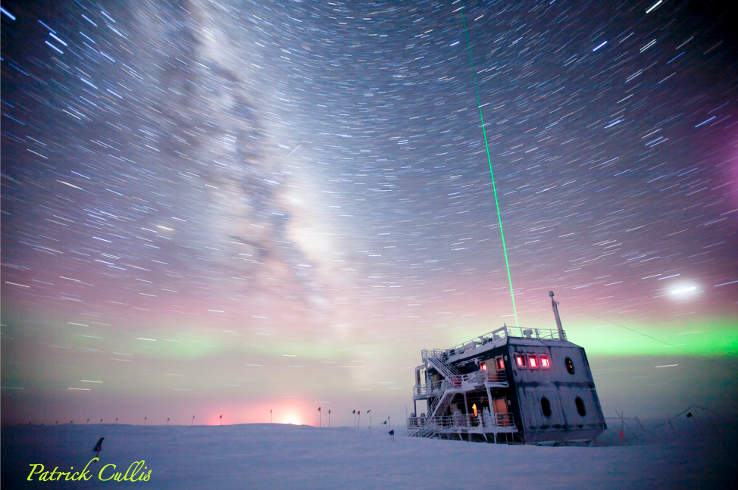
OAR
Earth System Research Laboratory – Global Monitoring Division
Providing the best possible information on atmospheric constituents that drive climate change, stratospheric ozone depletion, and baseline air quality.
Operate at all three stations:
South Pole - Atmospheric Baseline Observatory (2 year-round staff)
>150 atmospheric constituents measured – “Cleanest Air on Earth”
McMurdo - surface & stratospheric ozone
Palmer - flask sampling for GHG and ozone depleting substances
+ Antarctic UV network (all three stations)
Serves as the “caretaker” of the South Pole Clean Air Sector (CAS) in accordance with NSF’s Antarctic Specially Managed Area (ASMA) for current & future clean air/snow research.
Supports NSF-funded science projects through long-term baseline atmospheric measurement suite.

Slide 6
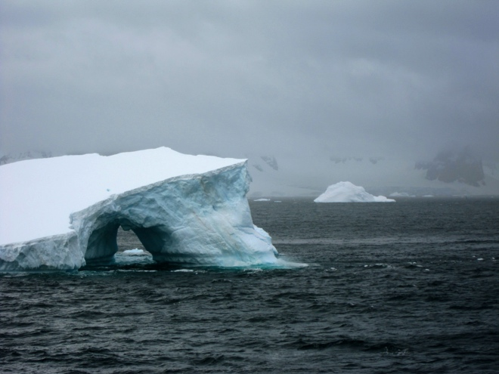
Moving forward
Identified needs –
Continued inter-agency support & use of NSF research infra-structure (land/facilities) and vessels (sea). Working Group 1 (8.1 Research, Support: Facilities and Equipment)
One or two weather satellites in a highly-elliptical orbit (HEO) over the Antarctic. NSF has some interest for communications purposes. (The Canadians are developing such a system for the Arctic now, called the Polar Communications and Weather (PCW) satellite mission.) A similar system over the Antarctic is desirable.
Working Group 2 (8.8 Communications and Information)
Continued support of NOAA shipping requirements and personnel deployments to the Antarctic stations and vessels.
Working Group 1 (8.1 Research, Support: Facilities and Equipment)?

