Slide 1
NSF/OPP USAP Information & Communications Technology Introduction
November 3, 2011
Patrick D. Smith
Manager, Technology Development, Polar Research Support
NSF/OPP Division of Antarctic Infrastructure and Logistics

Slide 2
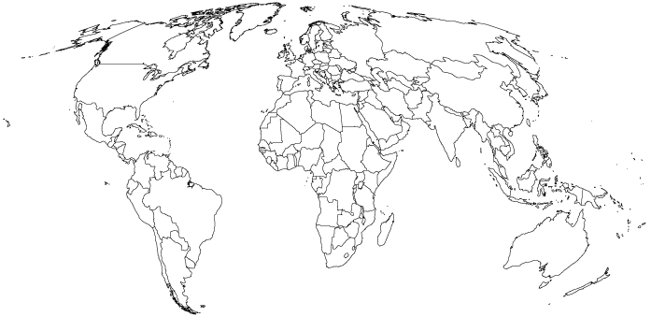
USAP ICT OPERATING LOCATIONS
ANTARCTICA
MCMURDO STATION
PALMER STATION
DEEP FIELD
SOUTH POLE STATION
INTERNATONAL
CHRISTCHURCH,
NZ
PUNTA ARENAS,
CL
CONUS
CENTENNIAL
CO
PORT HUENEME,
CA
SPAWAR
CHARLESTON,
SC
MARITIME
R/V LM
GOULD
R/V N.B.
PALMER

Slide 3











USAP ICT Service Community
Information Technology Supports a Broad NSF Customer Base
NBC
  Individual Scientists
  Guest Organizations
  Public (K-12, Media)
  International Collaborations
  Federal Agency Partners & Tenants
  USAP Operations Support Organizations
CTBTO
PREPARATORY COMMISSION
ratorium
®
expl
the museum of science,
art and human perception

Slide 4
USAP ICT Enterprise
Scope & Scale at a Glance
USAP Enterprise Network
Backbone for program communications
Centrally supported from Centennial, CO
Collapsed Service - Voice, Video, Data
Commodity Internet and Internet-2 Service
7 inter-site network links via satellite (both conventional commercial and non-standard)
Voice/Telephony
4 PBXs with 2,000+ subscriber ports
Global, enterprise VoIP system w/500+ phones
~ 149 IRIDIUM ISU mobile phones with > $900K in annual mobile satellite air time
Network
~ 290+ managed devices
~ 2,800 total ports
Data Systems
~ 300 servers, enterprise-wide
File Storage:
  Centennial, CO: 2.5 Terabytes
  McMurdo: 7 Terabytes
  South Pole: 2 Terabytes
  Research Vessels: 1.5 Terabytes
3,800+ enterprise e-mail addresses
100,000 to 115,000 e-mail messages to/from enterprise mail servers
Up 150 GBytes of data transferred daily from South Pole

Slide 5
USAP ICT Program
Functional Silos
Technical Services
Systems Architecture
Communications
Fixed Satellite Service
Land and Maritime M0bile Satellite Service
Information Systems
Campus LAN
Governance
IRM Policy & Guidance
HW/SW Engineering
Systems Design
Integration, Test, & Installation
O&M
General Electronics Bench Repair
Systems Lifecycle Planning
Radio – Long Haul
Radio – Land Mobile
Radiotelephone
Local/Long Distance Teleph0ne
Campus Telephone Exchange
Wide Area Data Networks
WiFi Access
Internet Service
Audio/Visual Production and Service
Video Conferencing
CATV
Data Centers
Intranet and Extranet/Web Portals
Desktop Computing, Seat Management
Office Automation Software
Enterprise E-mail
Data Relay Services
Enterprise Mission Information Systems
Supply Chain
Maintenance Mgmt
Medical
Deployment
Science Support Planning
Collaboration
Enterprise Architecture
Information Assurance
EM Spectrum Management
Project Management
Capital Investment Planning
Inter-Agency Agreement Management

Slide 6
USAP ICT v. Benchmark
NSF
  Admin applications
  ~ 1700 desktops
  1 operating location
  Centralized
  Significant in-house IT services
  No wide area network
  Commercial telecom service
  Moving services to the Cloud
USAP
  Mission applications
  ~ 1600 desktops
  10 operating locations
  Globally dispersed
  Outsourced IT services
  Wide Area Network
  Self-provided
  Cloud service on-Ice not practical (WAN delay, bandwidth)
≠
≈
≠
≠
≠
≠
≠
≠

Slide 7
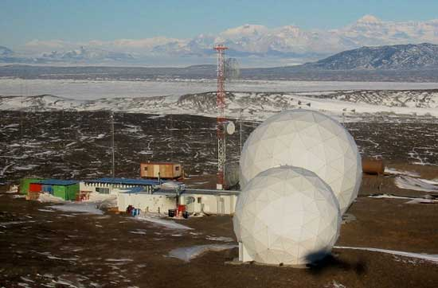
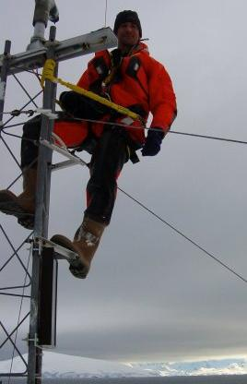
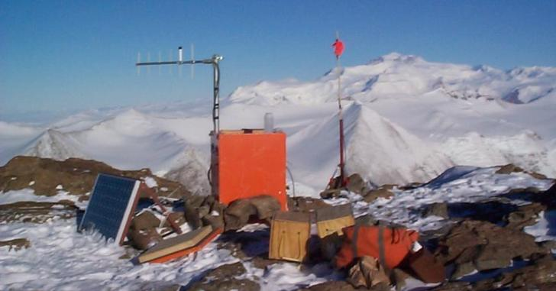
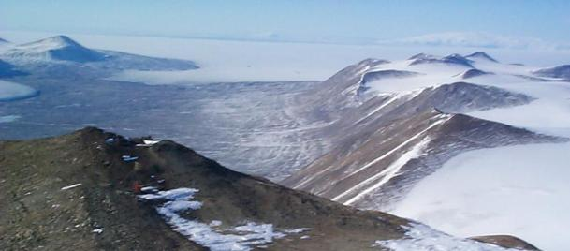
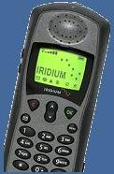
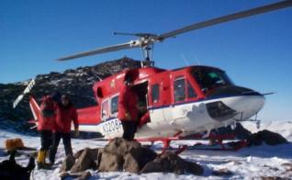
USAP ICT
“C” is for Communications
Remote Satellite Earth Station Operations and Maintenance
Communications Tower Rigging
Mountain-top Comm. Relays
Installation and Repair
HF Radio Communications Maintenance
Field Communications Issue and Maintenance
General Electronics Repair
7

Slide 8
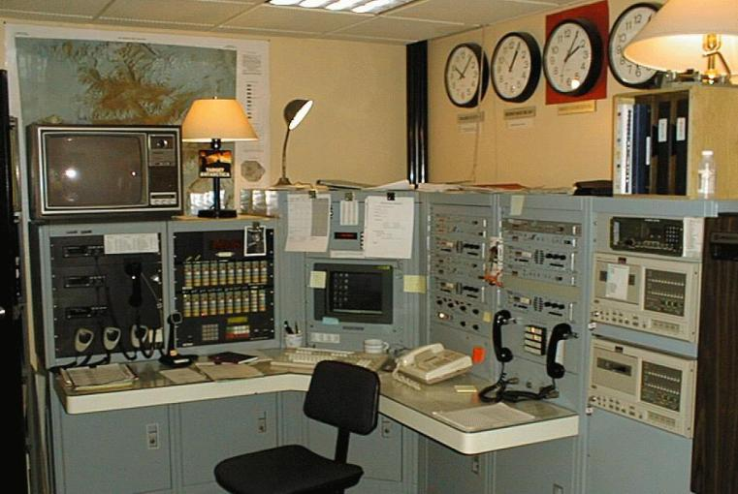
McMurdo Area Radio
Communications
Callsign – “MacOps”
24x7 Ops during Austral Summer
Lead Role for Emergency Response
Collaborative Ops
  SPAWAR ATC Comm.
  Shared Infrastructure
Integrated Ops
  HF Radio – Over the Horizon
  VHF LMR – Regional
  Telephone – IRIDIUM Mobiles
Inland Station Relay
  South Pole Station
  Regional Field Camps
MacOps serves as the McMurdo radio communications nerve center for deep field and regional safety communications

Slide 9

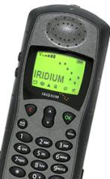
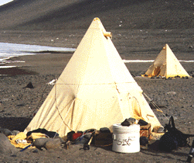

McMurdo Regional Field Communications
TYPICAL ACTIVITIES
Mountain-top Comm. Repeaters
Antenna/Tower Rigging
VHF Repeaters
UHF Radio Telephones
Trunk Microwave Radios
Satellite Earth Station
HF Radio Gear Issue and Maintenance
IRIDIUM Satellite Phone Issue
Remote HF Receive Antennas
Land Mobile Radio Operations
Remote LAN Access
WLANs And Links To McM Network
General Electronics Maintenance
MARBLE POINT
HELIPORT
MT. EREBUS
OBSERVATORY
RUNWAYS
FIELD SCIENCE CAMPS
SEA ICE HUTS
BLK. IS.
TELECOM
VACILITY

Slide 10
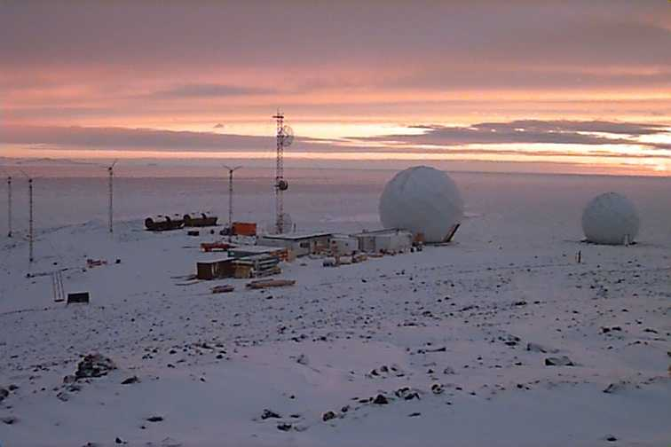
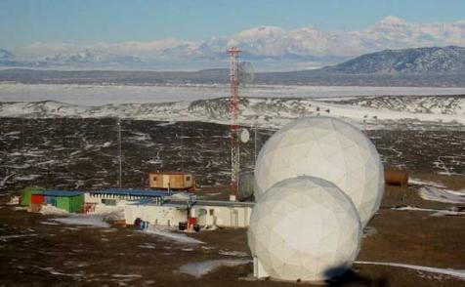
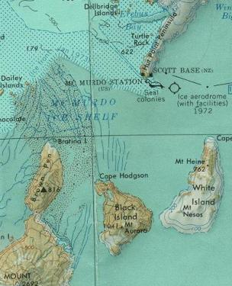
Black Island
Telecommunications Facility
11 METER EARTH STATION (future 60 Mb/s service)
7.2 METER EARTH STATION (present 10 Mb/s service)
HF RADIO RECEIVE ANTENNA FARM
AUTONOMOUS OPERATION
HYBRID DEG, WIND, & SOLAR POWER SYSTEM

Slide 11
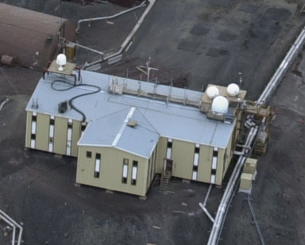
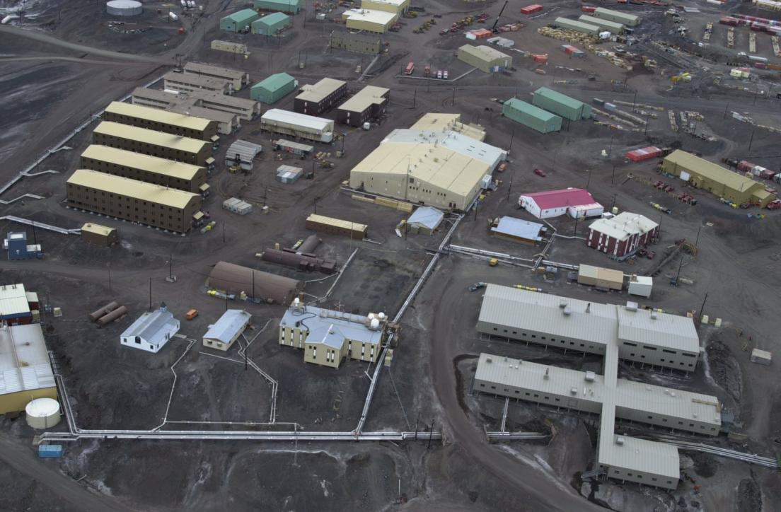
USAP ICT Other Services
Satellite Remote Sensing
NOAA POES HRPT, DMSP OLS, & TERRA/AQUA MODIS Data
L/S and L/S/X Band Receptors
Manufactured by SeaSpace Corporation
McMurdo – 2
Palmer Station – 1
R/V NB PALMER – 1
ASC Contractor Provides All O&M and System Life Cycle Planning

Slide 12


USAP ICT Other Services
Media and Broadcasting
Video Production
Training Videos
Stock Footage for NSF PAO
VNR Footage for NSF PAO
Support for visiting broadcast media
Video broadcasts to media
Web Services
USAP.GOV Portal
Station Intranets
Publishing of Antarctic Sun
USAP Program Announcements
USAP Program Operational Info
Radio &Television Services
AFRTS Station Manager
CATV Television Services for McM
NPR Streaming Radio Feed
http://www.usap.gov

Slide 13
USAP ICT Virtual Organization
NSF Program Office
USAP ICT Contract Suppliers
Antarctic Support Contractor
SPAWAR LANT
USAP ICT PMO
NOAA JPSS
NASA SCaN
Defense Media Activity
AFSPC/SMC Aerospace Corp
USAP ICT Government Suppliers
WL Pritchard & Co
DoD DISA
1 Civil Servant
NSF Staff
Augment
2 Civil Servants
4 Contractors
LEGEND
Civil Servant
≈ 130 Contractors
(varies with seasonal on-Ice workforce)
Contractor
Civil Servant
+
Contractor

Slide 14
USAP ASC Contractor ICT Services
“One-Stop-Shopping”
O&M
TENANTS, SCIENTISTS, GENERAL PROGRAM PARTICIPANTS, OPERATIONAL ORGANIZATIONS
PRIMARY SOURCE
USAP IT&C
PRODUCTS &
SERVICES
TECHNICAL OPERATIONS
CUSTOMER SERVICE
CONTENT &
ELECTRONIC
DISSEMINATION
ICT
PLANNING
TECHNOLOGY
MANAGEMENT
SYSTEMS
ENGINEERING
ICT
INFRASTRUCTURE
DEVELOPMENT
INFORMATION
SECURITY
OPERATIONAL COMPLIANCE, MANAGED SERVICES TO CUSTOMERS
OUTLETS
& MEANS
PROJECTS
SYSTEMS DESIGN
STRATEGY, LONG RANGE, ARCHITECTURE, CAPITAL INVESTMENT
LIFE CYCLE, INSERTION, REFRESH

Slide 15
USAP ICT Expenditures by Performing Organization - FY2011
Total Expenditures: $26.3M

Slide 16
USAP ICT FY2011
Draft Capital Plan Analysis
Plan Estimated Value - $6,736,000
ICT Portfolio Composition (by quantity)
Applications = 67%
Networks /ICT Facilities/Communications =33%
ICT ICT Investment Allocation
Core Requirements = 70%
Non-Discretionary Requirements = 19%;
ICT Lifecycle Analysis
Portfolio in transition >= 50%
Portfolio in Renewal = 23%
Portfolio in Rationalization = 19%
Portfolio in Retirement = 11%
Portfolio for Re-factoring = 2%
Portfolio for Replacement = 1%
ICT Strategic Category Assessment
Run-The-Business = 97%
Grow-The-Business = 3%
Transform-The-Business = 0%

Slide 17
USAP Communications Requirements Geospatial Distribution

Slide 18
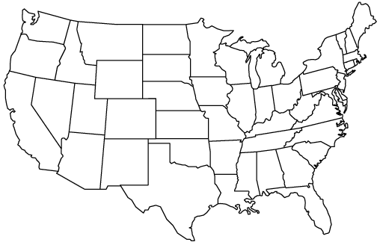

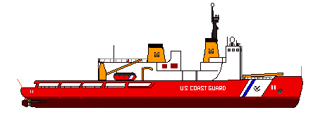

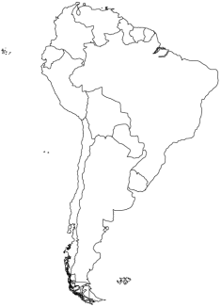





USAP Wide Area Network
Centennial, CO
Internet 2
Port Hueneme,
CA
R/V LM GOULD
Global
Information
Infrastructure
INMARSAT
Fleet Broadband
Internet
Palmer
R/V NB PALMER
INMARSAT
Fleet Broadband
VPN
Tunnel
South Pole
Deep Field
VPN
Tunnel
McMurdo
Christchurch
Punta Arenas

Slide 19



USAP IP Network Transit Partners
ABCD
ATM
Banking Network
Comprehensive Test
Ban Treaty Org.
GTS Network & USGS National
Earthquake information Center
Air Force Technical
Applications Center
US National Data Center

Slide 20












Current South Pole Satcomm. Architecture
TDRS F3/F5/F6
5 Mb/s
Centennial, CO
South PoleTDRSS Relay
S/Ku-Band
125 Mb/s
DS3
2.4m
X-Band
White Sands, NM
SkyNet-4C
T1
1.5 Mb/s
Oakhanger, UK
T1
1 Mb/s
1.5 Mb/s
9m
S/L-Band
GOES 3
Miami, FL
PSTN
12 x
2400 b/s
IRIDIUM Multi-Channel
Communications System
IRIDIUM
DOD IRIDIUM Gateway
Wahiawa, HI

Slide 21
Common ICT Challenges for USAP
Technology
Governance
Adoption of Best Practices
Project Management
Services Management
Technology Churn
Enterprise Architecture
Business Process Management
Privacy Protection
Adoption of Best Practices
Project Management
Cost of Technology
Services
Consumerization of IT
Increasing User Demand
Higher User Expectations
Privacy Protection

Slide 22
USAP ICT Unique Challenges
Technology
Logistics
No Indigenous Source of Supply On-Ice
Personal Services For Resident Workforce
Aging, End of Life IT Infrastructure and Applications
High Cost of International Telecommunications
Availability of International Telecomm.
Increasing Complexity of On-Ice Infrastructure
Information Security
Long Supply Chain
Limited Physical Access
On-Ice Working & Living Conditions
Severe Limitations for on-Ice Staffing
Human Factors
Services
Gypsy IT workforce on-Ice
On-Ice Working & Living Conditions
Recruiting/retaining Skilled IT Workers
Stringent Health Qualifications for Deployment
Domestic User Services for Resident s
User Expectations Set by CONUS Experience
Common Infrastructure for Science, Mission, Life-Safety, and Morale Services
Demand Pressure on WAN Bandwidth v. Cost
Information Security

Slide 23
Major Challenges for USAP ICT
Federal Information Security Compliance
CONUS Data Center Relocation & Disaster Recovery
Trusted Internet Connection
IPv6 Transition & Compliance
Legacy Mission Software Applications Phase-out
South Pole Station Broadband Communications Infrastructure
End-of-Life On-Ice ICT Infrastructure
ICT Organization Best Practices and Governance

Slide 24
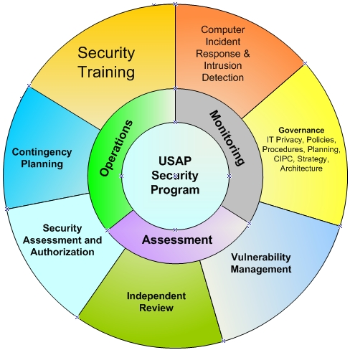
USAP Information Security Program

Slide 25
The South Pole ICT Challenge:
Bandwidth & Connectivity
2012 Forecast = 205 GB/day
Expected Daily Demand ( 75%) = 154 GB/day
Maximum Constrained Limit = 170 GB/day
Mission Requirement = Met (for now)

Slide 26

USAP Challenges
Satellite Communications
Conventional Geosynchronous (GEO) satellite coverage extends to 81º S, where the satellite appears at the local horizon.
McMurdo Station is barely able to receive service, with the satellite appearing at 3° above the horizon.
The deep interior of Antarctica, including South Pole Station, cannot be services via conventional GEO satellites. Extra-ordinary measures are required to provision service.
Palmer Station has a wide selection of conventional satellites with typical viewing elevations of 10°

Slide 27
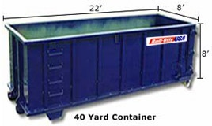

South Pole Satcomm.
Architecture Risk
Current broadband satellite constellation architecture based on end-of-life, extended-mission satellites
Choices and future supply highly limited
Critical dependence on NASA First Generation TDRSS, with high probability of failures near the end of the decade
Please Recycle
!
Short term solution only through ~ 2017

Slide 28


USAP Participant
Expectation Gap
BIG FAT PIPE INTERNET SERVICE
SODA STRAW REALITY
CONUS User Experience
Average Connection Speed = 5.8 Mbps
Average Peak Connection Speed = 21 Mbps
Average Advertised Download Speed = 14.6 Mbps
Average US Household Size = 2.6
Average Monthly Internet Cost (2-15 Mbps) = $38
McMurdo User Experience
Total Offered Bandwidth Inbound = 18 Mbps
Total Offered Bandwidth Outbound = 10 Mbps
Typical Austral Summer Population = 1000
Monthly Bandwidth Cost to NSF = $83,333
Monthly End-User Cost = $0
Antarctic Digital Divide

Slide 29
USAP Legacy Operations Applications
Supported Processes:
  Supply Chain and People Stream (e.g. Deployment)
Application
  Produced by Revelation Software, founded 1982
  Advanced Revelation (AREV) application introduced in 1987
  Long out of production with limited vendor support
  Flat file structure – not a modern relational database
  Data structure/access insecure for sensitive information
  MS-DOS based – last supported MS O/S is Windows XP
USAP Risks
  Self supporting with rare skilled database administrators
  Incompatible with modern PC computer architectures
  MS Win-XP end of extended support in 2014
  Network support becoming complex, labor intensive, and increasingly at risk
A dying application supporting mission essential business processes

Slide 30
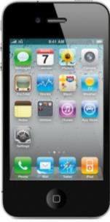
Mobility – The User Experience Game Changer
Morgan Stanley Market Research
Web 2.0 Summit – November 16, 2010, San Francisco
Smart Phone Sales To Outstrip PC+Laptop Sales in 2012
User Adoption Rate of Apple Mobility Products is Exponential

