Slide 1
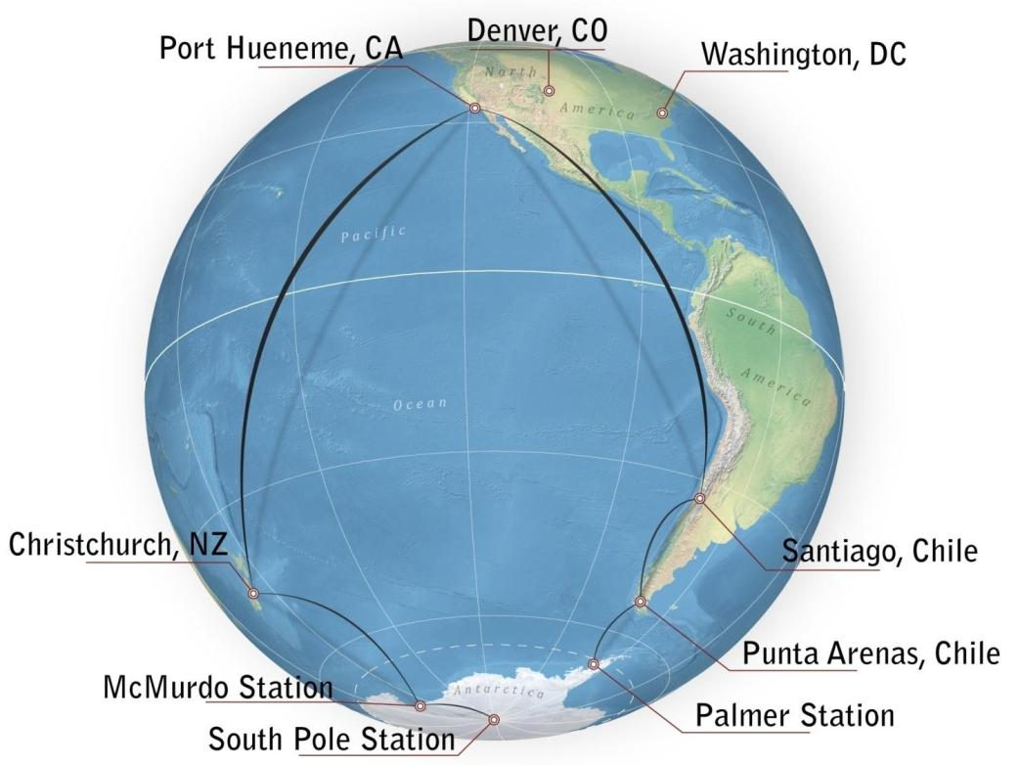
USAP Supply Chain
George Blaisdell
Operations Manager
3, 4 November 2011

Slide 2
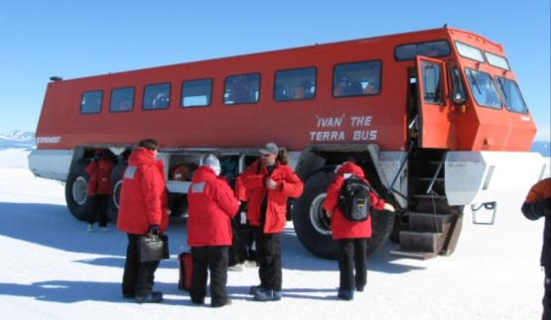
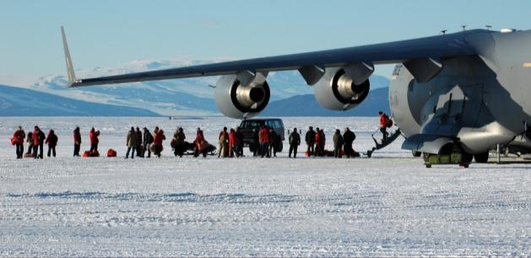
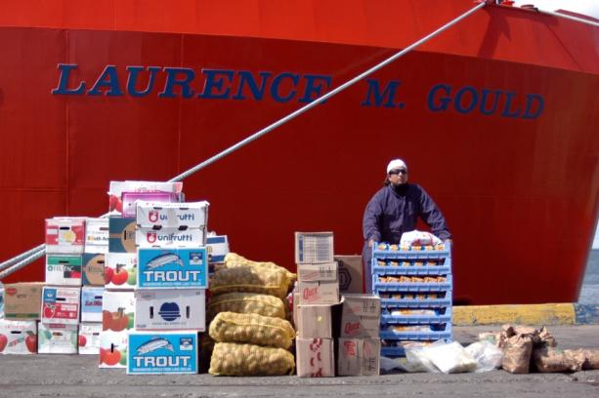
USAP Supply Chain
Learn & Generate Required Goods/Participant Lists
  grantees, work centers, USAP agencies
Collect & Procure Items
  consolidate cargo from CONUS participants
  $19M/yr purchases by prime contractor
  reservations and ticketing for 3,000 participants
Achieve Delivery to Timeline (south and north)
  Commercial
  Military
  Contract
  Self Established
Stocking, Warehousing, Inventory
  150,000 stock line items
  110,000 ft² heated
  75,000 ft² unheated
  700,000 ft² outdoor
Cargo Handling
  packaging
  special handling
  tracking
  USDA, Customs relationships

Slide 3
Typical Transportation Year
CONUS
Commercial Air lbs 465,000
Commercial Ship lbs 1,800,000
MSC Cargo South lbs 6,887,000
MSC Cargo North lbs 9,285,000
Passengers 3,000
FUEL
Diesel/Jet gal 5,200,000
Gasoline gal 150,000
TRAVERSE OPERATIONS
MCM-SPOLE lbs 4,000
MCM-SPOLE gal 94,000
SPOLE-MCM lbs 68,300
Inter-continental
CHC-MCM lbs 4,345,000
MCM-CHC lbs 1,822,000
CHC-MCM PAX 2,900
MCM-CHC PAX 3,300
Intra-Continental
MCM-SPOLE lbs 1,397,000
MCM-FIELD lbs 1,090,000
MCM-SPOLE PAX 631
MCM-FIELD PAX 569
MCM-SPOLE gal 533,800
MCM-FIELD gal 189,000
59 C-17’s + 413 LC-130’s + 11 Airbus’s + 2 B757’s + 4 C-130’s

Slide 4
USAP Supply Chain
Cargo Collection
Major Operational Centers
Investigator’s Home Institutions
Major Purchasing Centers
North America
McChord
AFB
Schenectady
Denver
Arlington
Pt.
Hueneme
Charleston
Hickam AFB
New Zealand
South America

Slide 5
USAP Supply Chain
Passenger Embarkation
Major Operational Centers
Investigator’s Home Institutions
Major Embarkation Points
North America
McChord
AFB
Schenectady
Denver
Arlington
Pt.
Hueneme
Charleston
San Francisco, Los Angeles
Hickam AFB
Miami
New Zealand
South America

Slide 6
Schenectady
USAP Supply Chain
Primary Nodes
Pt.
Hueneme
North America
Arlington
Denver
Charleston
South
America
Punta Arenas
Antarctica
Palmer
Field B
South Pole
New Zealand
Field A
Field C
Christchurch/
Pt. Lyttelton
McMurdo

Slide 7
USAP Supply Chain
Connections and Modes
Pt.
Hueneme
North America
South
America
Punta Arenas
Antarctica
Palmer
Field B
South Pole
New Zealand
Field A
Field C
Christchurch/
Pt. Lyttelton
McMurdo

Slide 8
USAP Supply Chain
Connections, Modes & Means
Pt.
Hueneme
North America
M – Military
C – Commercial
K – Contract
a – aircraft
s – ship
t – tractor train
South
America
Ca
Ks
Ma, Ca
Cs
Punta Arenas
Ms
Ks
Antarctica
Palmer
Ms, Cs
Field B
South Pole
New Zealand
t, Ma, Ka
Field A
t, Ma, Ka
Field C
t, Ma, Ka
Christchurch/
Pt. Lyttelton
Ma, Ka
McMurdo
Ma
Ms
Ks

Slide 9
USAP Supply Chain
Connections, Modes, Means & Timing
Pt.
Hueneme
North America
South
America
M – Military
C – Commercial
K – Contract
a – aircraft
s – ship
t – tractor train
all year
Ca
Ks
rarely
Ma, Ca
all year
Cs
Punta Arenas
Aug;
Oct-Feb
all year
Ms
Antarctica
Jan
Ks
all year
Palmer
Ms, Cs
t, Ma, Ka
Feb
all year
Field B
South Pole
Dec-Jan
New Zealand
Field A
Field C
t, Ma, Ka
Nov-Jan
Nov-Feb
t, Ma, Ka
Christchurch/
Pt. Lyttelton
Ma, Ka
Aug;
Oct-Feb
McMurdo
Ma
Feb
Jan-Feb
Ms
Ks

Slide 10
USAP Supply Chain
Pt.
Hueneme
North America
Southbound Cargo and Fuel Movements (10⁶ lb)
South
America
0.1
0.02
1.0
0.35
Punta Arenas
37.1
(fuel)
0.5
Antarctica
Palmer
8.6
1.2
Field B
South Pole
New Zealand
Field A
Field C
0.5
7.5
Christchurch/
Pt. Lyttelton
2.4
McMurdo
4.3
10.0

Slide 11
USAP Supply Chain
Pt.
Hueneme
North America
Northbound Cargo Movements (10⁶ lb)
South
America
0.1
0.02
3.0
0.35
Punta Arenas
0
(fuel)
0.5
Antarctica
Palmer
9.2
Field B
1.5
South Pole
New Zealand
Field A
0.5
Field C
7.0
Christchurch/
Pt. Lyttelton
1.3
McMurdo
1.8
10.5

Slide 12
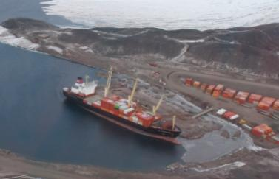
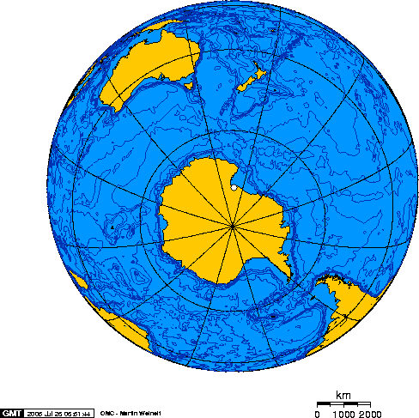
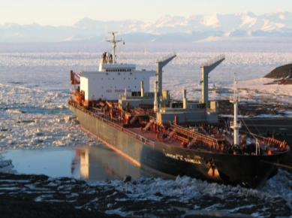
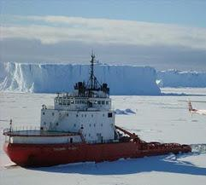
Supply Chain
Cargo Ship & Tanker
$62k/day (est.)
Cargo Ship Route
(10,000 mi)
Tanker Route
(11,500 mi)
Southern Ocean
$77k/day
Ross Sea
McMurdo Sound
McMurdo
$55k/day (est.)
IGNATYUK Route
(7,800 mi)

Slide 13
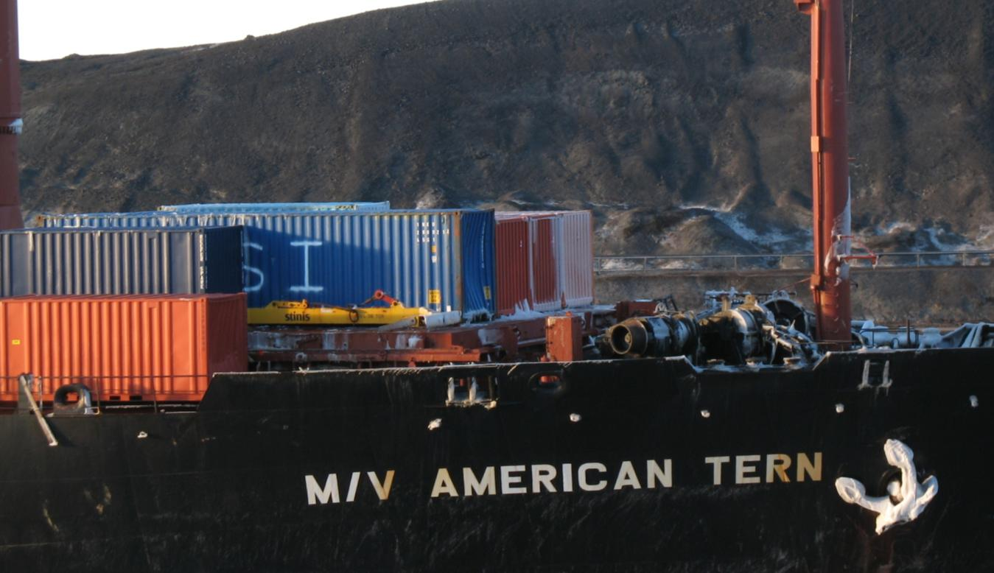
Supply Chain
Cargo Ship & Tanker
Southern Ocean: Vigorous Storms
Damaged Containers
Icing
Destroyed Winches

Slide 14
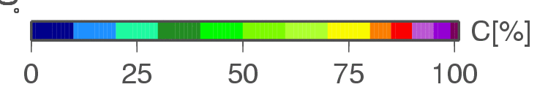
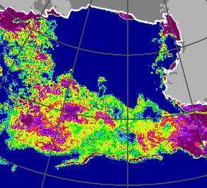
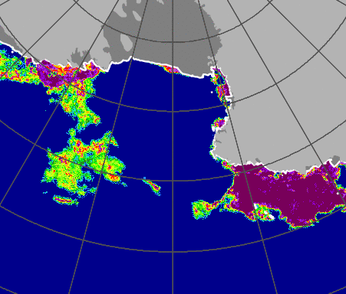
Supply Chain
Cargo Ship & Tanker
% Pack Ice Cover
Ross Sea: Select time for passage when open water corridor exists
7 of 8 years open corridor on 5 February
18 Jan 2009
5 Feb 2009

Slide 15
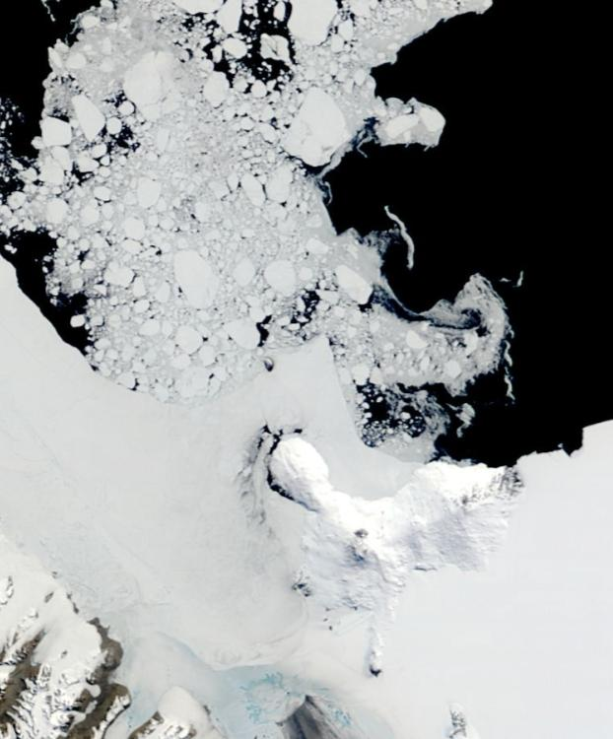
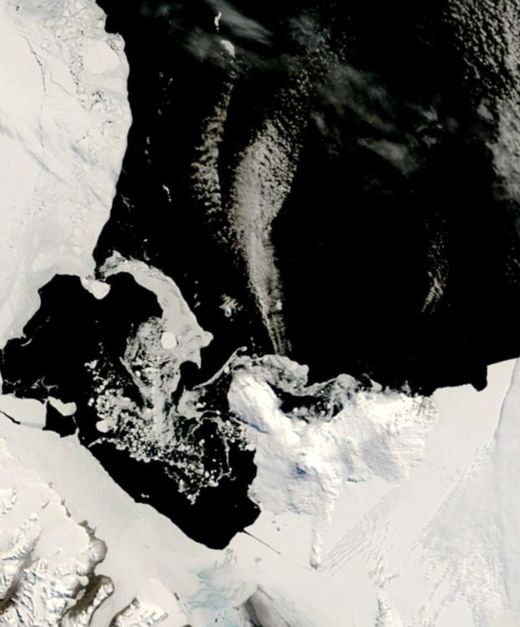
Supply Chain
Cargo Ship & Tanker
McMurdo Sound: Select time for passage when ice edge at maximum southern extent
Ross Island
Ross Island
25 miles
McMurdo
25 miles
McMurdo

Slide 16
Supply Chain
Cargo Ship & Tanker
Ice at Weakest
Ice Growth

Slide 17
Supply Chain
Cargo: Procured and Delivered
Procurement Lead Time to Delivery On Station = ROS date
  Continental Area (McMurdo + South Pole + Deep Field)
    90 to 105 days via commercial surface
    52-60 days via commercial air
    365 days via Annual Resupply Vessel
  Peninsula Area (Palmer + Research Vessels)
  110 days via commercial surface delivery plus 4-5 day RV Transit: 115 days
    21 days via commercial air plus 4-5 day RV Transit: 25 days
    scheduled around vessel in-port periods

Slide 18
USAP Supply Chain
Schedule Realities
Activity | APR |  |  |  | May |  |  |  | JUN |  |  |  | JUL |  |  |  | AUG |  |  |  | SEP |  |  |  | OCT |  |  |  |  | NOV |  |  |  | DEC |  |  |  | JAN |  |  |  | FEB |  |  |  |  |  | MAR
APP Funding Approval |  |  |  |  |  |  |  |  |  |  |  |  |  |  |  |  |  |  |  |  |  |  |  | $
McMurdo Station Ops | Winter |  |  |  |  |  |  |  |  |  |  |  |  |  |  |  |  |  | WinFly |  |  |  |  |  | Summer |  |  |  |  |  |  |  |  |  |  |  |  |  |  |  |  |  |  |  |  |  | Winter
South Pole Station | Winter |  |  |  |  |  |  |  |  |  |  |  |  |  |  |  |  |  |  |  |  |  |  |  |  |  |  |  | WF | Summer |  |  |  |  |  |  |  |  |  |  |  |  |  |  | Winter
Palmer Station | Winter |  |  |  |  |  |  |  |  |  |  |  |  |  |  |  |  |  |  |  |  |  |  |  |  |  |  |  |  | Summer
McMurdo Tanker Operations
Dry Cargo Vessel Ops |  |  |  |  |  |  |  |  |  |  |  |  |  |  |  |  |  |  |  |  |  |  |  |  |  |  |  |  |  |  |  |  |  |  |  |  |  |  |  |  |  |  |  |  | VV
Pegasus Fuel Hose Pick Up |  |  |  |  |  |  |  |  |  |  |  |  |  |  |  |  |  |  |  |  |  |  |  |  |  |  |  |  |  |  |  |  |  |  |  |  |  |  |  |  |  |  |  |  | Hose P/U
Annual Planning Conference |  |  |  |  | APC
FY funding approved (usually)
RUSH purchases = Approved FY $$
to meet ship sail date
$19M/yr ($7.2M or 38% in 3 months)
LATE YEAR purchases = Approved SIPs
+ O&M projects
Ship loading + departure PH

Slide 19
Supply Chain
Fuels

Slide 20
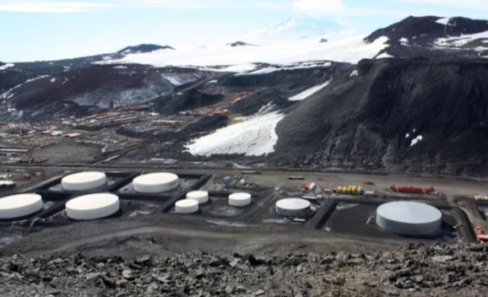
Supply Chain
Fuels

Slide 21
Supply Chain
Fuels

Slide 22
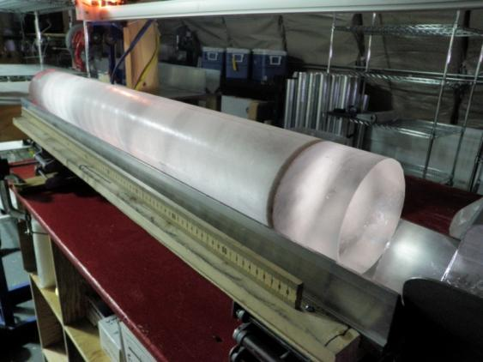
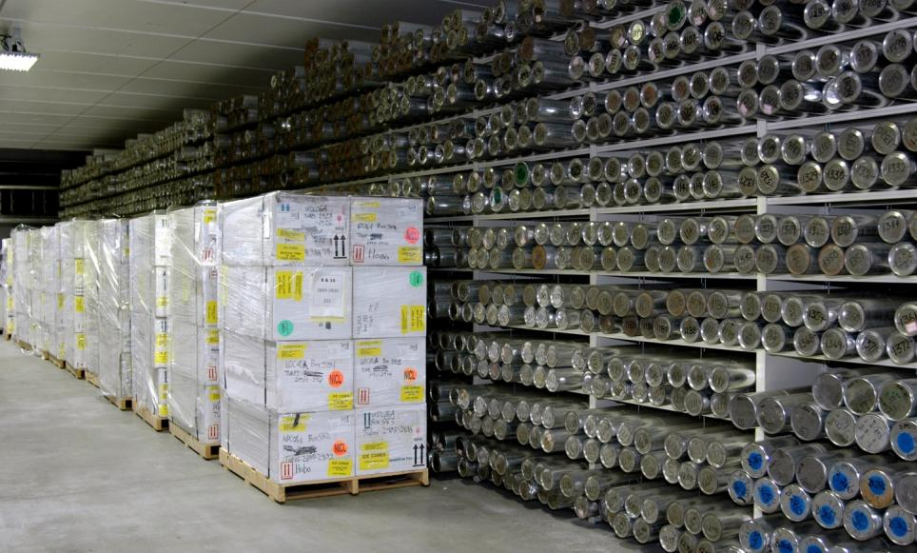
Supply Chain
Special Handling
Expertise with keep frozen, do not freeze, target temperature, and live samples
Transfers between modes and handling groups
Redundant and contingency provisions
Legal and regulatory challenges
Tracking & monitoring tools
Export controlled items

Slide 23
Supply Chain
Population Management
Forecasting/Actual Populations all stations
Screen deployment qualifications before ticketing
Ticketing for 2,500 non-military ($6M)
Airline ticket concessions
NAVCHAPS movement PH/MCM
Orientations for RPSC/NANA
Technical Event processing
Major events planning
Constraints
Must be PQ’d to ticket
  Advanced ticketing minimum 3 weeks
  Redeployments from Ice always changing
Hotel rooms in CHC after earthquake
Deployment software (manual Excel) is inefficient
Emergency assistance (mass communications)

Slide 24
Supply Chain
Population Management

Slide 25
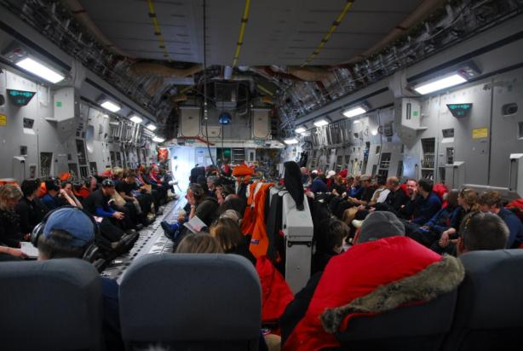
Supply Chain
Population Management
Recommended Deployment Dates

Slide 26
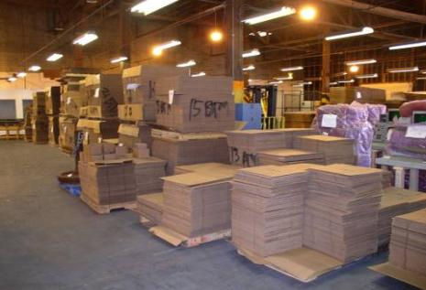
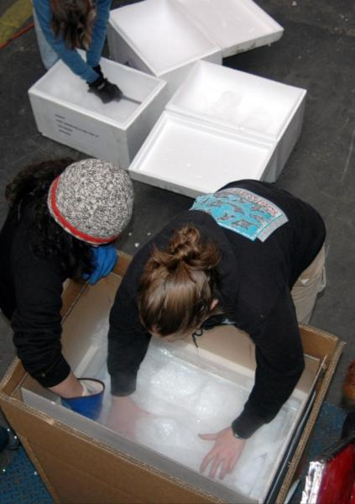
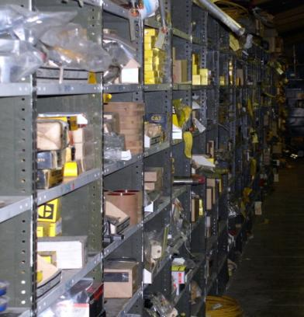
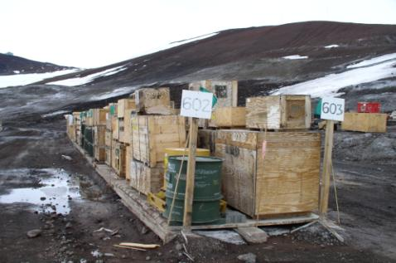
Supply Chain
Legacy Infrastructure & Systems
27 warehouses MCM
- manpower intensive to manage, inventory, issue, order, replace
- need consolidation of bldgs & cover for outside matl’s & new freezer warehouse
Must support equipment from 1954 to present (excessive range of parts)
Legacy purchasing and tracking software (circa 1990) hampers innovation and evolution
No bar coding & no RFID for tracking or inventory
Insufficient Do Not Freeze storage
Material handling equipment old – inefficient & safety issues
Fuel storage capacity at McMurdo insufficient for even single missed delivery
Fuel storage capacity at South Pole insufficient to last 12 months

