Slide 1
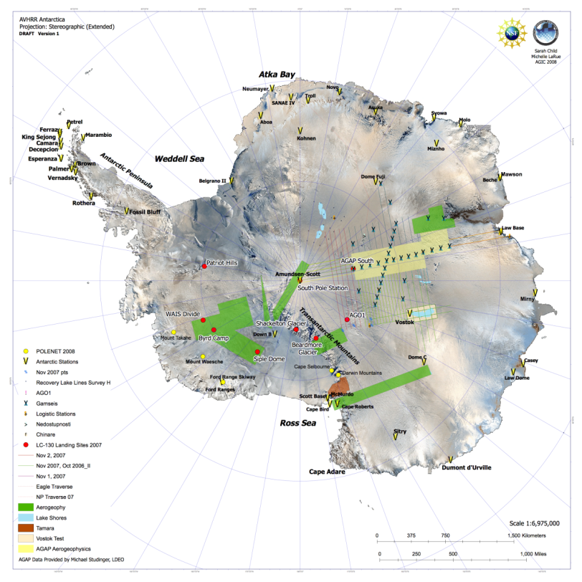
Support Integration The AGAP Project
AGAP Project
4 C-17 fuel drops
1 large, 1 medium camp
Fuel caches
Traverse
Three Twin Otters
Four international Antarctic Programs

Slide 2
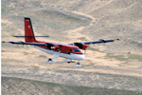
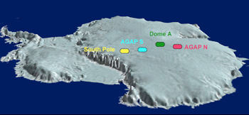
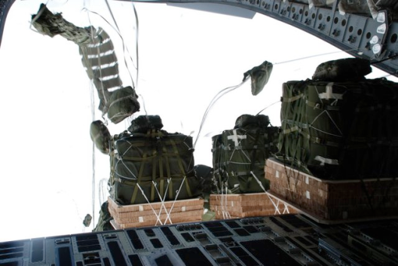
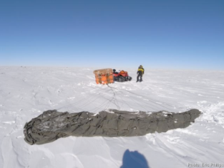
http://www.ldeo.columbia.edu/res/pi/gambit/index.htm

