Slide 1
Committee on Equal Opportunities in Science and Engineering (CEOSE) Update
Alicia J. Knoedler, CRA, PhD
Executive Associate Vice President for Research
University of Oklahoma
CEOSE Liaison to BOAC
November 30, 2016

Slide 2
CEOSE Activities
CEOSE Workshop on Assessing Performance and Developing an Accountability System for Broadening Participation
CEOSE Biennial Report
NSF INCLUDES Update

Slide 3
CEOSE REminder
The Committee on Equal Opportunities in Science and Engineering (CEOSE) is a Congressionally mandated advisory committee to the National Science Foundation that advises the Foundation on policies and programs to encourage full participation by women, underrepresented minorities, and persons with disabilities within all levels of America’s science, technology, engineering and mathematics enterprise. (http://www.nsf.gov/od/iia/activities/ceose/index.jsp)
16 members, mostly from universities (http://nsf.gov/od/iia/activities/ceose/members.jsp)
Diverse in gender, race/ethnicity, position, discipline, region, age, disabilities.
We each serve as a CEOSE liaison to another advisory committee within NSF.
Every two years, the Committee prepares and transmits to the NSF Director a report on its activities during the previous two years and proposed activities for the next two years.
NSF’s positive response to the CEOSE call in the 2011-2012 report for a “bold new initiative” included the development of NSF INCLUDES.

Slide 4
Workshop on Assessing Performance and Developing an Accountability System for Broadening Participation
Held October 13-14, 2016, with approximately 50 participants/attendees.
Purpose: Contribute to creating a framework for developing and implementing a broadening participation-accountability system useful for federal agencies, institutions of higher education, private foundations, and non-profit and for-profit organizations.
Panel Presentations, each followed by small and large group discussion
Panel presentation on exemplary programs, their implementation, and scalability
Panel presentation on metrics and measurement
Panel presentation on developing and implementing an accountability system for broadening participation
Outcomes include a workshop report and content to be included in the 2015-2016 CEOSE Biennial Report.

Slide 5
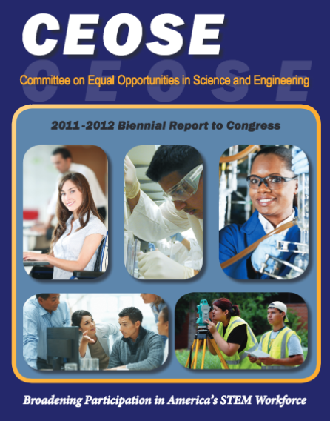
2015-2016 CEOSE Biennial Report
The 2015-2016 Biennial Report (defined as 3rd in a series) is to articulate a set of recommendations for assessing the bold new initiative, with emphasis on developing an accountability system
Some Super Awesome cover that we are designing now!!!

Slide 6
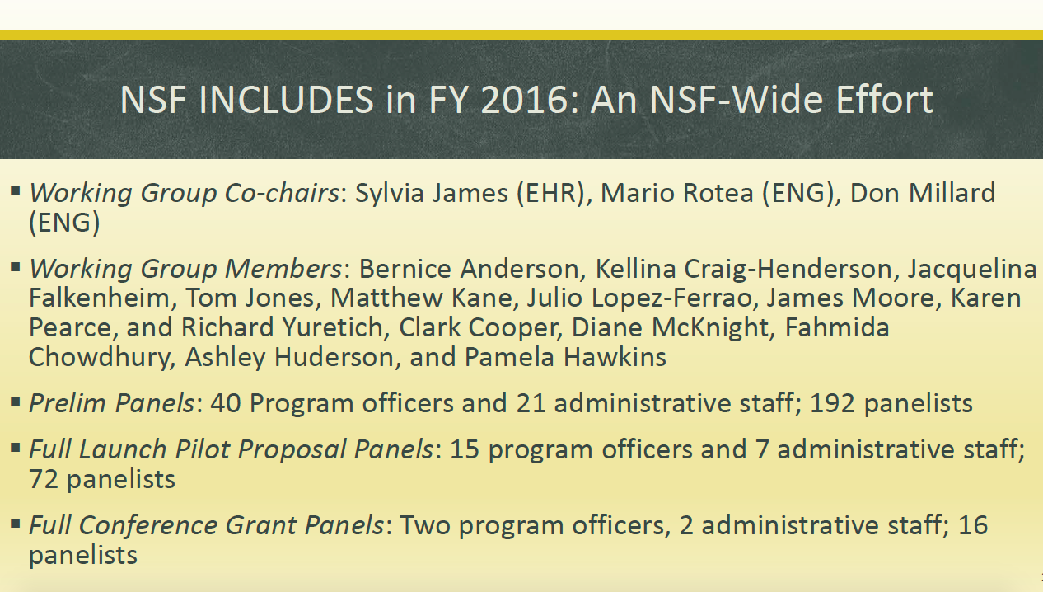

Slide 15
Special Thanks to Dr. SuzI Iacono, Dr. Bernice Anderson, Dr. Joan Ferrini-Mundy, Dr. Grace Wang, Dr. Roger Wakimoto, Joan Burrelli, Vickie Fung, and my CEOSE colleagues.

Slide 16
Questions?

