Slide 1
Benchmarking
Business & Operations Advisory Committee
May 2016

Slide 2
President’s Management Agenda Benchmarking for Efficiency & Effectiveness
Five areas for benchmarking across government mission support functions
Financial Management
Acquisition
Human Capital
Information Technology
Real Property
To benchmark: cost of service, quality of service, customer satisfaction
So agencies can learn from one another
Notes:
Effort was part of the President’s Second Term Management Agenda
First year was FY13 data – recognition that process not perfect
FY14 data used revised definitions; for NSF, did not include IPAs in our personnel base and removed all grant funding from our budget base.
FY15 data revised some definitions again.

Slide 3
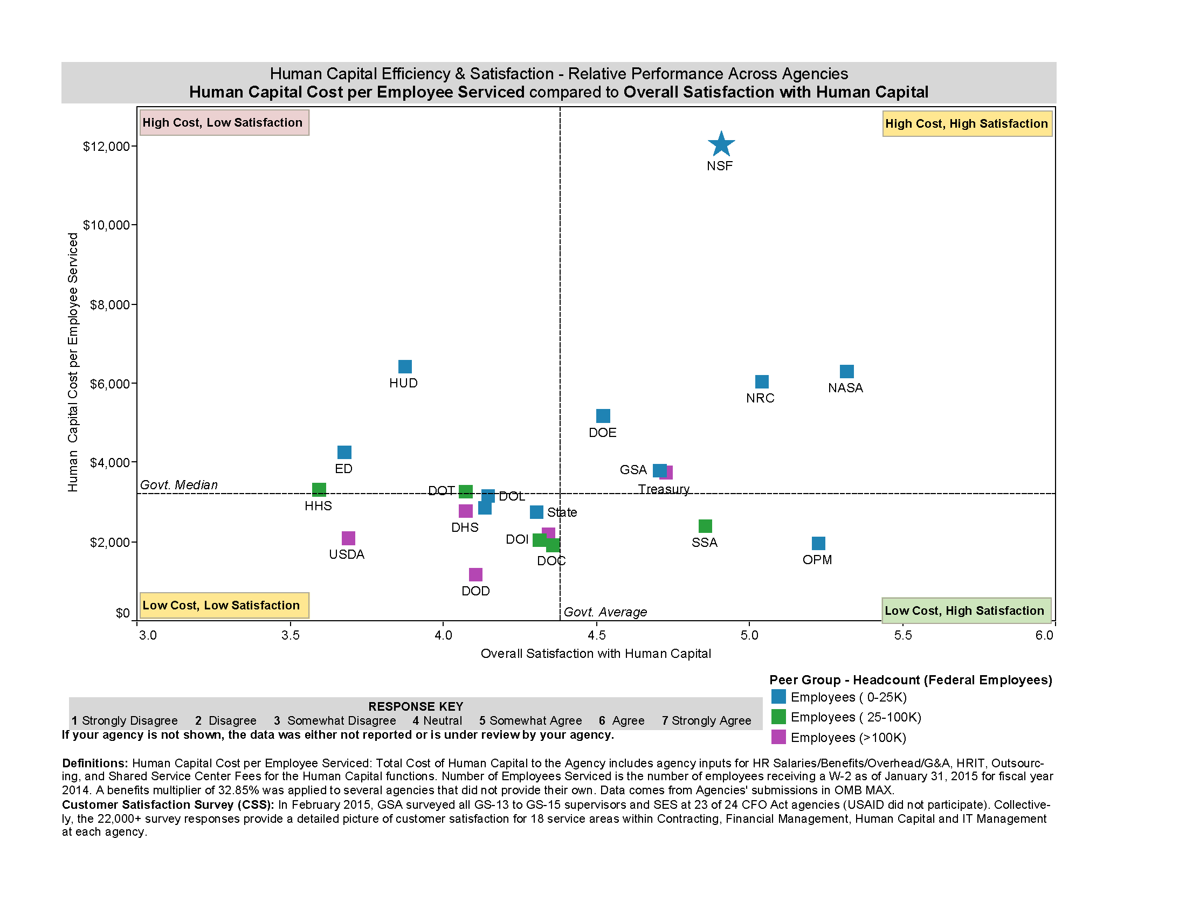
Notes:
This slide is one that NSF made using the OPM/GSA data; we were such an outlier for the cost per employee serviced that they thought there must be an error in the data. While NSF is high cost, the satisfaction is also high.
As we provided the information for FY15, we see the cost per employee coming down, but do not yet have data on customer satisfaction.

Slide 4
Notes:
When we look at training and development in particular, we are in the same ball park as other agencies on the high end of the cost spectrum, and had the highest rating for customer service.

Slide 5
Notes:
This is pulled from the government-wide benchmarking website. It has agency-wide information for some of the agencies we consider our counterparts (NASA, NRC), as well as DOE (with Departmental Administration pulled out) and Department of Commerce, with most components split out.
NASA and NRC are both report agency-wide numbers only. Numbers of staff are quite a bit larger than NSF base.
DOE is also quite a bit larger; has a model that distributes costs for “centralized” activities across the agency.
DOC is also quite a bit larger; has a model that centralizes costs for centralized functions in the Departmental Management component, which has a comparatively small number of staff, while distributing actual operations
If I look at the DOC subcomponents most similar to NSF (NIST, NOAA, Census, PTO), the satisfaction rates are similar to NSF. And if I looked at the training and development spending, it is a much closer to the NSF levels as well.

Slide 6
There Are Limits to Cost-Cutting
Average Human Capital Cost per Employee vs. Servicing Ratio for Components at CFO Act Agencies, FY2014
HC Cost per Employee Serviced ($)
Diminishing returns set in at a servicing ratio of roughly sixty
HC Servicing Ratio
60
n = 84 components
Notes:
This slide is a partial response to the question, “How is the OMB/government using the benchmarking data?”
They are looking at scatter plots like this where you can see an inflection point at about 60 employees per HR person where adding additional employees per HR person does not lead to as much reduction in cost per employee serviced as earlier in the spectrum.

Slide 7
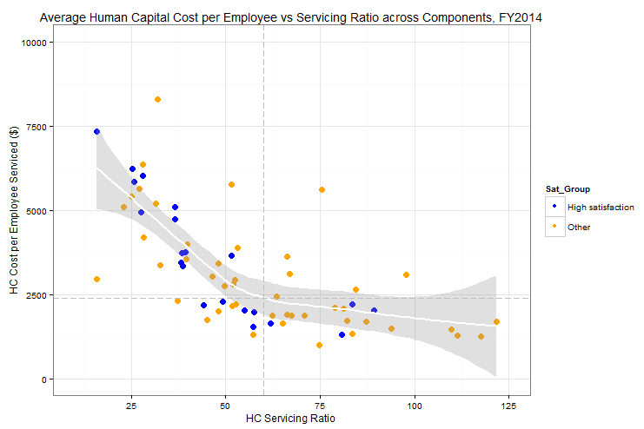
Where Cost Reduction Begins to Jeopardize Service
Average Human Capital Cost per Employee vs. Servicing Ratio for Components at CFO Act Agencies, FY2014
High Satisfaction
Low-Med Satisfaction
Agency components with a servicing ratio > 60 rarely achieve high satisfaction.
60
n = 69 Components
Notes:
This version of the scatter plot also incorporates customer satisfaction, and you can see that, while high servicing ratios lead to lower cost (as a general trend), they also seem to lead to lower satisfaction with the service.
The question: for an agency like NSF, where is the sweet spot?

Slide 8
Questions for the Committee
How has benchmarking been helpful? What value has it brought for your organization?
How do you determine what is a good result and what is not?
When your results indicate you are an outlier, how do you respond?
How do you identify appropriate organizations to benchmark against?

